Slide 1

Lecture 13 – Syntactic parsing
Baojian Zhou
DATA130030.01 (自然语言处理)
School of Data Science Fudan University
05/31/2023
Notes:
The terms "constituency parsing" and "syntactic parsing" are often used interchangeably in NLP, but they represent different ideas in the broad scope of parsing.
1. Syntactic Parsing(句法分析): This is the overall process of analyzing the grammatical structure of a sentence according to a given grammar. It involves determining the way a sentence is broken down into its constituent parts(组成部分), also known as parse trees (解析树). Syntactic parsing can include both constituency parsing(成分分析) and dependency parsing (依赖分析), as they are both methods of representing a sentence's syntactic structure.
2. Constituency Parsing(成分分析): This is a type of syntactic parsing that breaks down sentences into sub-phrases, also known as constituents, that belong to specific categories in the grammar. Constituency parsers generate a parse tree where each node represents a constituent (a word or a group of words that function as a single unit).

Slide 2
Outline
Constituency Parsing
Notes:
我们分成两个部分介绍，一个是 Constituency Parsing 成分解析; 另一个是依赖解析，我们首先看成分分析。

Slide 3

What is constituency?
Syntactic constituency is the idea that groups of words can behave as single units, or constituents.
How do words group together? Consider noun phrases (NP):
Harry the Horse
a high-class spot such as Mindy’s
the Broadway coppers
the reason he comes into the Hot Box
they
three parties from Brooklyn
Notes:
首先，解释一下什么是constituency，作名词时译为“（选区的）选民；支持者；（一批）顾客”。这里，constituency的含义是成分。在成分分析中，有一个核心的概念就是成分，或者说短语。
句法成分是一个什么样的想法呢？是一组词表现为一个单位或者不同成分。
英语中的单词如何组合在一起？考虑名词短语，即围绕至少一个名词的一系列单词。 以下是一些名词短语的例子：1) 马哈利; 2) 像Mindy‘s这样的高级场所; 3) 百老汇铜管乐队; 4) 他进入热箱的原因; 5) 他们; 6) 来自布鲁克林的三个党派。

Slide 4
How do we know what is a constituent?
Use NP as an example: phrases before a verb.
three parties from Brooklyn arrive …
a high-class spot such as Mindy’s attracts …
the Broadway coppers love …
they sit …
But not all individual words that make up a grammatical NP
from arrive …
the is …
as attracts …
spot sat …
Notes:
我们凭什么觉得这些词组合在一起（或“构成成分”）？英语语法告诉我们，它们都可以出现在相似的句法环境中，例如在动词之前。
例如之前的名词构成成分例子中，都可以后面接上动词构成句子的一部分。

Slide 5
How do we know what is a constituent?
Preposed or postposed constructions
Use prepositional phrase (PP) as an example
On September seventeenth, I’d like to fly from Atlanta to Denver
I’d like to fly on September seventeenth from Atlanta to Denver
I’d like to fly from Atlanta to Denver on September seventeenth
But not individual words
On September, I’d like to fly seventeenth from Atlanta to Denver
On I’d like to fly September seventeenth from Atlanta to Denver
I’d like to fly on September from Atlanta to Denver seventeenth
Notes:
这种构成成分有很多种类。例如，前置结构或者后置结构，这里以介词短语定语为例。
例如，在以下示例中，prepositional phrase 介词短语 On September seventeenth 可以放置在多个不同的位置，包括开头（前置）或结尾（后置）。但是你不能把这个短语拆开放到句子中。

Slide 6
What is parsing?
The term parsing comes from Latin pars (orationis), meaning part of speech.
Parsing is the process of analyzing a string of symbols, either in natural language, computer languages or data structures, conforming to the rules of a formal grammar.
S=The dog saw a man in the park.
S
NP
VP
Det
N
V
NP
PP
the
dog
saw
Det
N
P
NP
a
man
in
Det
N
the
park
Notes:
Parsing 解析一词来自拉丁语 pars (orationis)，意思是词性。
解析、句法分析或句法分析是按照形式语法规则分析自然语言、计算机语言或数据结构中的一串符号的过程。
我们有没有一种系统的方法能够解析一个句子，或者说生成一个句子。
例如，我们之前的一些实例，语法树，The dog saw a man in the park.
如何生成这样的语法树？

Slide 7
Outline
Constituency Parsing
Context-free Grammars (CFG)
Notes:
1. 所以你得有一定的规则，Constituency grammars成分文法,上下文无关文法；2. 然后再有 Constituency Parsing 成分解析; 3. 依赖解析

Slide 8
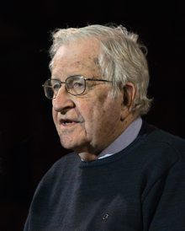
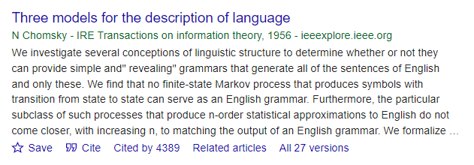
Context-free grammar (CFG)
The most widely used formal system for modeling constituent structure in English and other natural languages is the Context-Free Grammar or CFG.
Chomsky, N. 1956. Three models for the description of language. IRE Transactions on Information Theory, 2(3):113–124.
Avram Noam Chomsky (1928-) is an American linguist, philosopher, cognitive scientist, historical essayist, social critic, and political activist. Sometimes called “the father of modern linguistics”.
Notes:
用于对英语和其他自然语言中的构成成分进行建模的最广泛使用的形式系统是上下文无关语法或 CFG。
论文发表在。。。

Slide 9
Context-free grammar (CFG)
Context-free grammar consists of a set of rules, each of which expresses the ways that symbols of the language can be grouped and ordered together, and a lexicon of words and symbols.
Example: NP (or noun phrase) can be composed of either a ProperNoun or a determiner (Det) followed by a Nominal; a Nominal in turn can consist of one or more Nouns. We can define rules, say
NP → ProperNoun, NP → Det Nominal
Nominal → Noun | Nominal Noun
Det → a, Det → the, Noun → flight
Notes:
上下文无关语法由一组规则组成，每个规则都表达了语言符号可以组合和排序在一起的方式，以及单词和符号的词典。
名词短语可以由专有名词或限定词（Det）后接名词组成； 一个名词又可以由一个或多个名词组成。 我们可以定义，
具体来说，nominal 名词性定义是名词、名词短语或任何用作名词的词或词组。 它也被称为实体。 这个词来自拉丁语，意思是“名字”。 名词性可以是句子的主语、句子的宾语或谓语主格，它跟在连接动词之后并解释主语是什么。 名词用于比简单名词提供更多细节。Nominal 名词性词。
为什么叫context-free 上下文无关语法？后面会进一步解释。

Slide 10
Rules, Symbols, and Arrow
Rules: NP → Det Nominal, Nominal → Noun, Noun → flight
Symbols that are used in a CFG are divided into two classes.
Terminals: the symbols terminal that correspond to words in the language (“the”, “nightclub”).
Non-terminals: express abstractions over these terminals. (Noun, Nominal)
Arrow →
The left of the arrow: non-terminal
The right of the arrow: an ordered list of one or more terminals and non-terminals
Notes:
与语言中的单词（“the”、“nightclub”）相对应的符号终结称为终结符号。
Non-terminals 非终结符; 在这些终结符上表达抽象的非终结符被调用。
名词和Nominal的区别
箭头的习惯

Slide 11
A CFG is a generator
NP → Det Nominal: we can read the → arrow as “rewrite the symbol on the left with the string of symbols on the right”.
Example: How to generate a flight from a set of rules?
1) So starting from the symbol: NP
2) use the rule to rewrite NP as: Det Nominal
3) rewrite Nominal as Noun: Det Noun
4) and finally rewrite these parts-of-speech as: a flight
We say the string a flight can be derived from the non-terminal NP.
This sequence of rule expansions is called a derivation.
NP → Det Nominal
NP → ProperNoun
Nominal → Noun
Det → a
Det → the
Noun → flight
Notes:
我们定义这些非终结符合规则rules，是为了干什么？来构建一个生成器，对吧？用右边的符号串重写左边的符号;
我们说这个名词短语字符串 a flight 可以从非终结符 NP 导出。
上面这四个步骤，这一系列规则扩展称为推导。

Slide 12
A derivation as a parse tree
A parse tree for “a flight”
NP → Det Nominal
Det → a
Nominal → Noun
Noun → flight
Start symbol: We need a start symbol so that every derivation starts from a unique symbol S.
S
NP
NP
Det
Nominal
Det
Nominal
a
Noun
a
Noun
flight
flight
Notes:
为了更好的理解这个推导过程，我们用解析树表示推导; 解析树或者叫语法分析树。
CFG 定义的形式语言是可从指定的开始符号派生的字符串集。 每个文法都必须有一个指定的起始符号，通常称为 S。

Slide 13
A derivation of a sentence - parse tree
If we have rules, A → a, A → b, A → c, then just write A → a | b | c
S
NP
VP
Example:
Fed raises interest rates
S → NP VP
NP → Noun | Noun Noun
Noun → Fed | interest | rates
VP → Verb VP
Verb → raises
Noun
Verb
NP
Fed
raises
Noun
Noun
interest
rates
Notes:
例子：美联储加息。[The Federal Reserve System (also known as the Federal Reserve or simply the Fed) is the central banking system of the United States of America. 联邦储备系统（也称为美联储或简称美联储）是美国的中央银行系统。]
[In syntactic analysis, a constituent is a word or a group of words that function as a single unit within a hierarchical structure. 在句法分析中，成分是一个词或一组词，它们在层次结构中作为一个单元发挥作用。]

Slide 14
A derivation of a sentence
A noun phrase followed by a verb phrase (VP)
S → NP VP
But what is exactly a VP?
1) a verb followed by a NP: VP → Verb NP
I prefer a morning flight
2) a verb followed by a prepositional (PP): VP → Verb PP
Students leave on Thursday
3) a verb followed by a NP and a prepositional (PP): VP → Verb NP PP
Students leave Shanghai in the morning
Many others …
PP generally has a preposition followed by a noun phrase
PP → Preposition NP Example: from Shanghai, on Wednesday, …
Notes:
我们来构建更复杂的一些规则，一个句子：一个动词后跟一个名词短语和一个动词短语

Slide 15
Grammar rules
S → NP VP
Exp: I + want a morning flight
NP → Pronoun | Proper-Noun | Det Nominal
Exp: I | Shanghai | a + flight
Nominal → Nominal Noun | Noun
Exp: morning + flight | flights
VP → Verb | Verb NP | Verb NP PP | Verb PP
Exp: do | want + a flight | leave + Shanghai + at night | leave + on Thursday
PP → Preposition NP
Exp: from + Shanghai
All rules from Lexicon

Slide 16
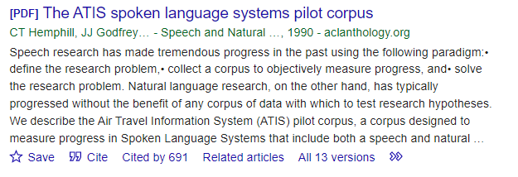
Grammar rules - Lexicon
Lexicon: a lexicon is the set of rules that introduce terminal symbols.
Noun → flights | flight | breeze | trip | morning
Verb → is | prefer | like | need | want | fly | do
Adjective → cheapest | non-stop | first | latest | other | direct
Pronoun → me | I | you | it
Proper-Noun → Alaska | Baltimore | Los Angeles | Chicago | United | American
Determiner → the | a | an | this | these | that
Preposition → from | to | on | near | in
Conjunction → and | or | but
The above is from ATIS (Air Traffic Information System)-language.
Notes:
词汇, 词典和语法规则
ATIS-language 航空旅行信息系统 (ATIS) 试点语料库，该语料库旨在衡量口语系统的进展，包括语音和自然语言组件。

Slide 17
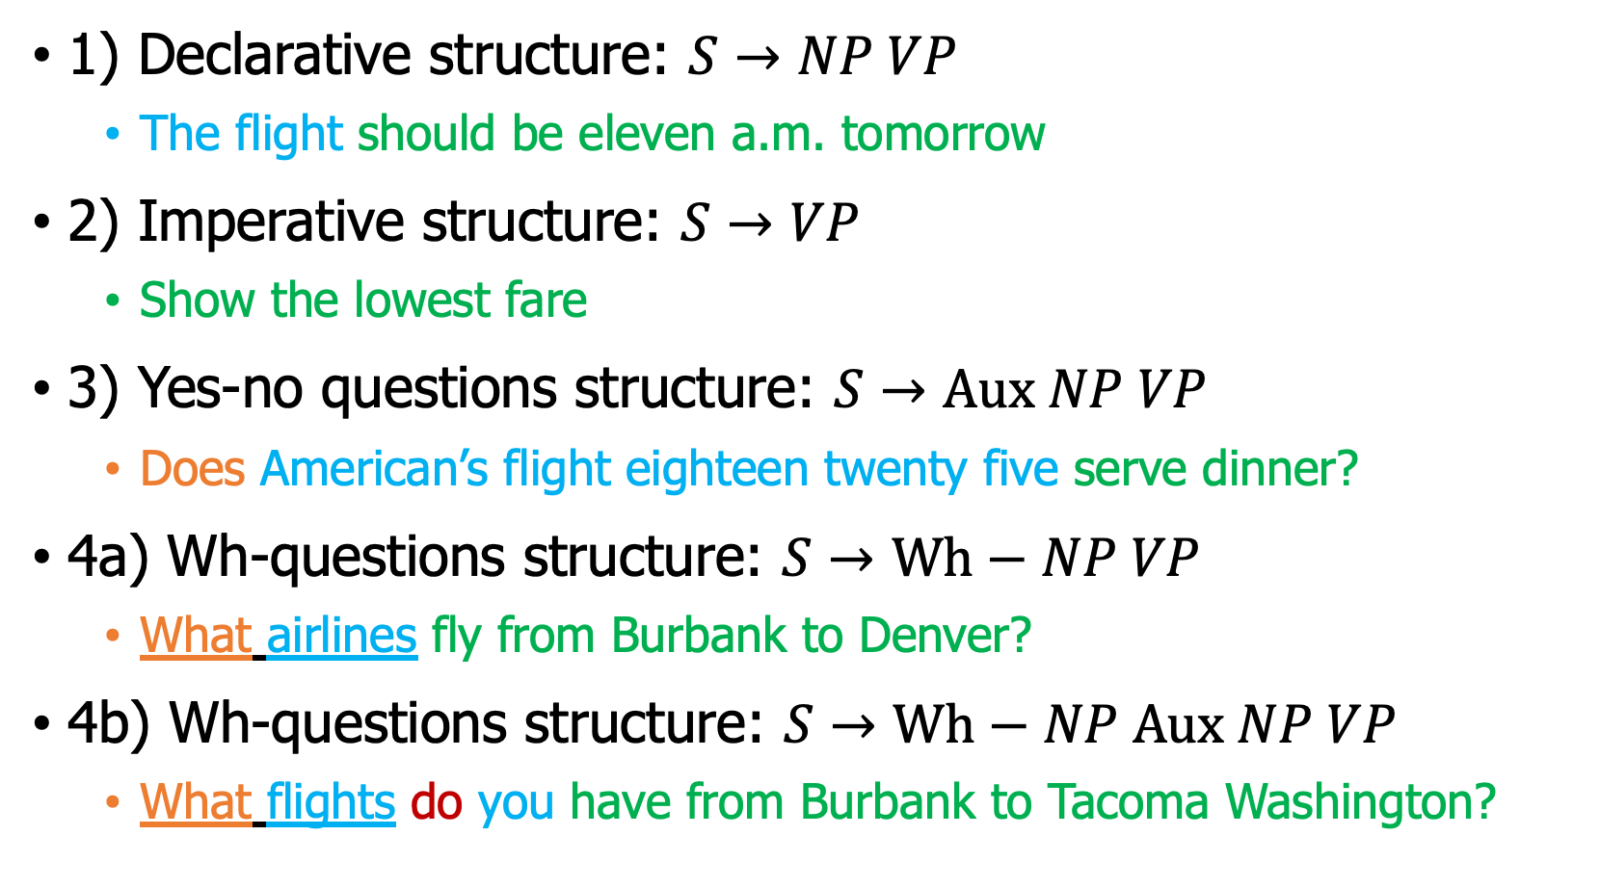
Example rules in English grammar
1) Declarative structure: $S→NP VP$
The flight should be eleven a.m. tomorrow
2) Imperative structure: $S→VP$
Show the lowest fare
3) Yes-no questions structure: $S→Aux NP VP$
Does American’s flight eighteen twenty five serve dinner?
4a) Wh-questions structure: $S→Wh−NP VP$
What airlines fly from Burbank to Denver?
4b) Wh-questions structure: $S→Wh−NP Aux NP VP$
What flights do you have from Burbank to Tacoma Washington?
Notes:
在英语句子的结构中，有四个特别常见和重要：陈述句、祈使句、是非疑问句/一般疑问句和 wh-疑问句/特殊疑问句。
4a) wh-subject-question 结构与陈述式结构相同，只是第一个名词短语包含一些 wh 词。
4b) 在 wh-non-subject-question 结构中，wh-短语不是句子的主语，因此句子中包含另一个主语。
这里有个长距离依赖问题。
Clauses and Sentences 可以构建从句和句子的规则

Slide 18
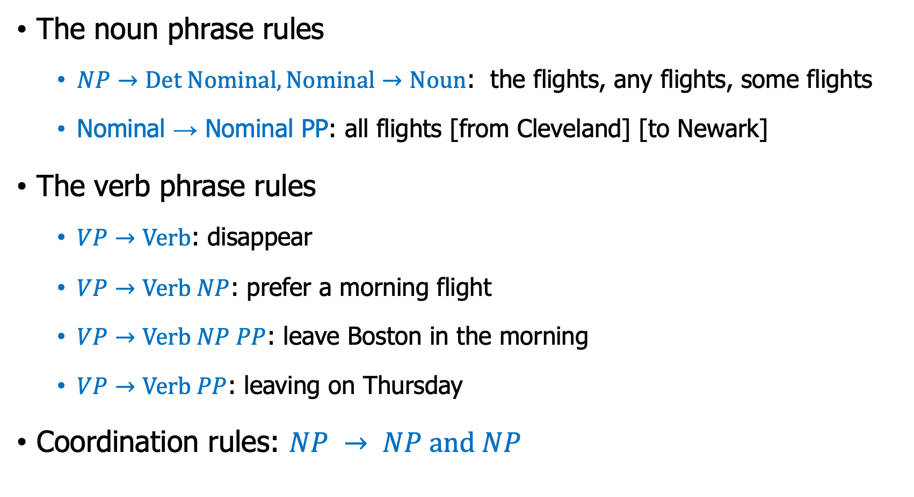
Rules of Phrases
The noun phrase rules
$NP→Det Nominal, Nominal→Noun$: the flights, any flights, some flights
$\text{Nominal}\text{ → }\text{Nominal} \text{PP}$: all flights [from Cleveland] [to Newark]
The verb phrase rules
$VP→Verb$: disappear
$VP→Verb NP$: prefer a morning flight
$VP→Verb NP PP$: leave Boston in the morning
$VP→Verb PP$: leaving on Thursday
Coordination rules: $NP → NP and NP$
Notes:
我们的 L0 语法介绍了英语中最常见的三种名词短语类型：代词、专有名词和the NP 结构。
头部名词后面可以接后置修饰语

Slide 19
A parse tree as a bracketed notation
Example: I prefer a morning flight
Parse tree
more compact format bracketed notation:
[_{S}[_{NP} [_{Pro} I]] [_{VP} [_{V} prefer] [_{NP} [_{Det} a] [_{Nom} [_{N} morning] [_{Nom} [_{N} flight]]]]]]
S
NP
VP
Pro
Verb
NP
I
prefer
Det
Nominal
a
Nominal
Noun
Noun
flight
morning
Notes:
1. 位了存储更方便 bracketed notation, 括号符号

Slide 20
How to get a bracketed notation ?
Exp: I prefer a morning flight
Use Pre-Order Traversal:
pre_order_traversal(root):
print(“[”+root->data)
for child in root.children
if (root->child != NULL)
pre_order_traversal(root->child)
print(“]”)
[_{S}[_{NP} [_{Pro} I]] [_{VP} [_{V} prefer] [_{NP} [_{Det} a] [_{Nom} [_{N} morning] [_{Nom} [_{N} flight]]]]]]
S
NP
VP
Pro
Verb
NP
I
prefer
Det
Nominal
a
Nominal
Noun
Noun
flight
morning

Slide 21
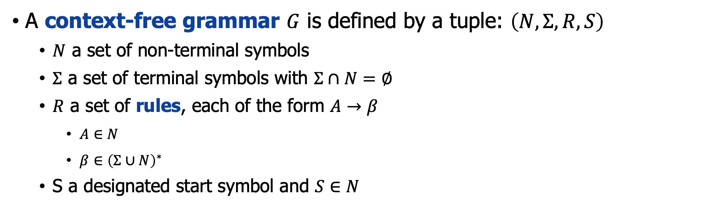
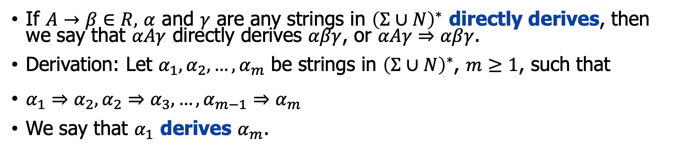
Formal definition of CFG
A context-free grammar $G$ is defined by a tuple: $\left(N,Σ,R,S\right)$
$N$ a set of non-terminal symbols
$Σ$ a set of terminal symbols with $Σ∩N=∅$
$R$ a set of rules, each of the form $A→β$
$A∈N$
$β∈{\left(Σ∪N\right)}^{∗}$
S a designated start symbol and $S∈N$
If $A→β∈R,$ $α$ and $γ$ are any strings in ${\left(Σ∪N\right)}^{∗}$ directly derives, then we say that $αAγ$ directly derives $αβγ$, or $αAγ⇒αβγ$.
Derivation: Let $α_{1}, α_{2}, …, α_{m}$ be strings in ${\left(Σ∪N\right)}^{∗}$, $m≥1$, such that
$α_{1}⇒α_{2},α_{2}⇒α_{3},…, α_{m−1}⇒α_{m}$
We say that $α_{1}$ derives $α_{m}$.
Notes:
上下文无关文法，若一个形式文法 G = (V, Σ, P, S) 的产生式规则都取如下的形式：A -> α。其中 A∈V ，α∈(V∪Σ)*
N是非终结符号的有限集合。它们表示在句子中不同类型的短语或子句。
$Σ$是终结符的有限集合，无交集于N，它们构成了句子的实际内容。
R是从N到${\left(Σ∪N\right)}^{∗}$的关系 是有限集合。R的每一个元素叫做文法的“规则”或“产生式
S是开始变量，用来表示整个句子（或程序）的开始。它必须是N的元素。
上下文无关文法由一组规则或产生式组成。
[The problem of mapping from a string of words to its parse tree is called syntactic parsing. 从一串词映射到它的解析树的问题称为句法解析。]

Slide 22
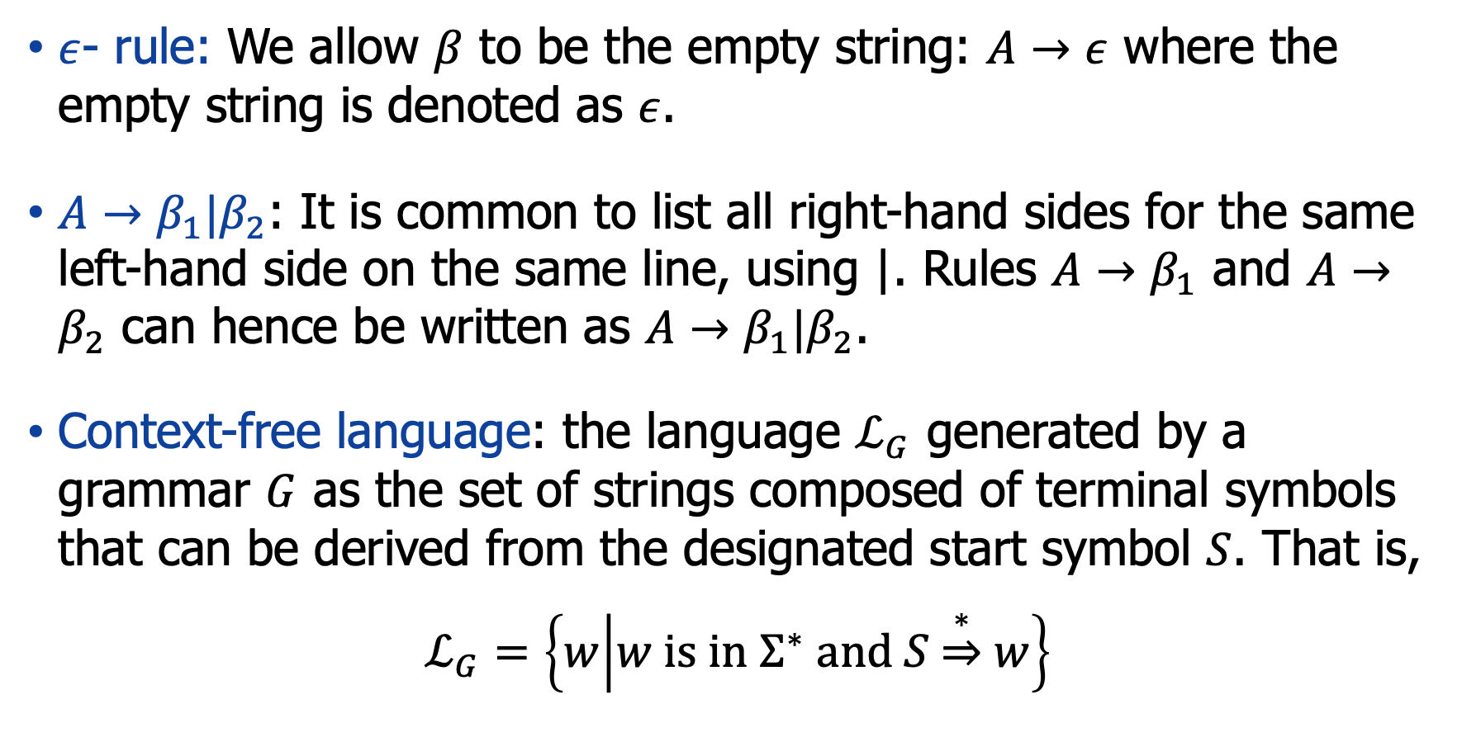
Formal definition of CFG
$ε$- rule: We allow $β$ to be the empty string: $A→ε$ where the empty string is denoted as $ε$.
$A→β_{1}|β_{2}$: It is common to list all right-hand sides for the same left-hand side on the same line, using |. Rules $A→β_{1}$ and $A→β_{2}$ can hence be written as $A→β_{1}|β_{2}$.
Context-free language: the language $ℒ_{G}$ generated by a grammar $G$ as the set of strings composed of terminal symbols that can be derived from the designated start symbol $S$. That is,
$$ℒ_{G}=\left\{w | w is in Σ^{∗} and S\underset{⇒}{∗}w\right\}$$
Notes:
由文法 𝐺 生成的语言 ℒ_𝐺 作为由可以从指定的起始符号 𝑆 派生的终结符号组成的字符串集合。

Slide 23
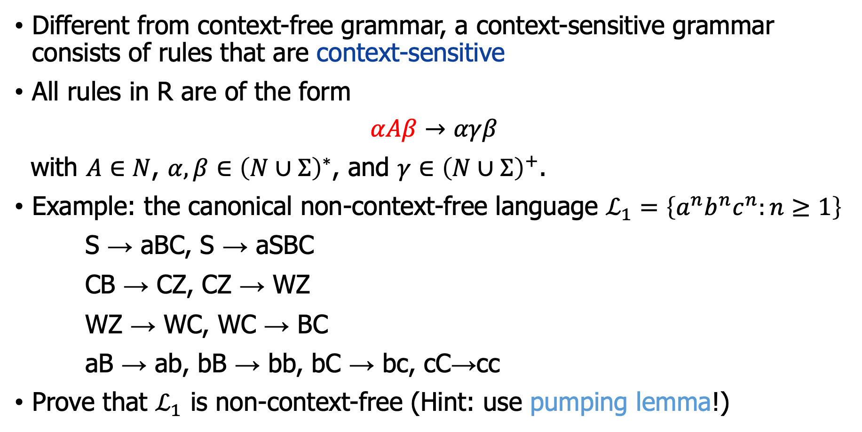
Context-sensitive grammar
Different from context-free grammar, a context-sensitive grammar consists of rules that are context-sensitive
All rules in R are of the form
$$αAβ→αγβ$$
with $A∈N$, $α,β∈{\left(N∪Σ\right)}^{∗}$, and $γ∈{\left(N∪Σ\right)}^{+}$.
Example: the canonical non-context-free language $ℒ_{1}=\left\{a^{n}b^{n}c^{n}:n≥1\right\}$
S → aBC, S → aSBC
CB → CZ, CZ → WZ
WZ → WC, WC → BC
aB → ab, bB → bb, bC → bc, cC→cc
Prove that $ℒ_{1}$ is non-context-free (Hint: use pumping lemma!)
Notes:
上下文有关文法
In theoretical computer science and mathematics, the theory of computation is the branch that deals with what problems can be solved on a model of computation, using an algorithm, how efficiently they can be solved or to what degree (e.g., approximate solutions versus precise ones). The field is divided into three major branches: automata theory and formal languages, computability theory, and computational complexity theory, which are linked by the question: "What are the fundamental capabilities and limitations of computers?“
在理论计算机科学和数学中，计算理论是一个分支，它处理在计算模型上可以解决哪些问题，使用算法，解决问题的效率或程度（例如，近似解与精确解） ）。 该领域分为三个主要分支：自动机理论和形式语言、可计算性理论和计算复杂性理论，它们通过以下问题联系起来：“计算机的基本能力和局限性是什么？”

Slide 24
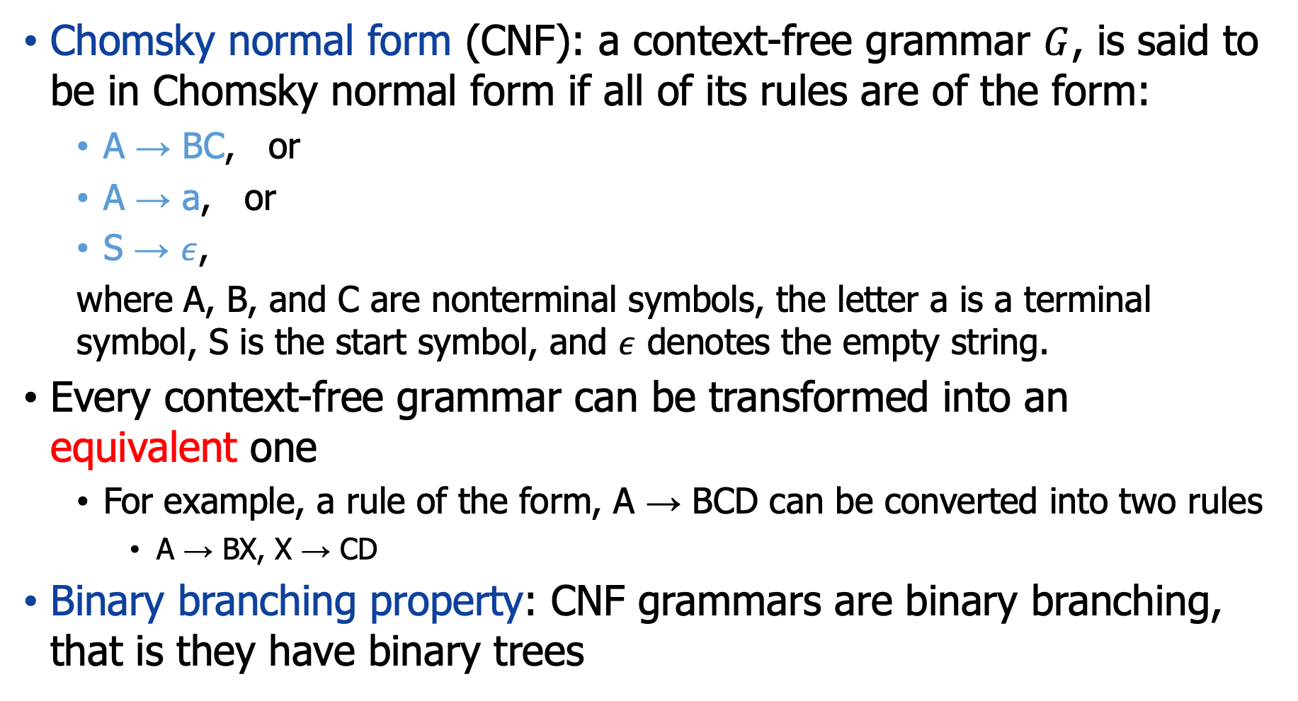
Grammar equivalence and normal form
Chomsky normal form (CNF): a context-free grammar $G$, is said to be in Chomsky normal form if all of its rules are of the form:
A → BC, or
A → a, or
S → $ε$,
where A, B, and C are nonterminal symbols, the letter a is a terminal symbol, S is the start symbol, and $ε$ denotes the empty string.
Every context-free grammar can be transformed into an equivalent one
For example, a rule of the form, A → BCD can be converted into two rules
A → BX, X → CD
Binary branching property: CNF grammars are binary branching, that is they have binary trees
Notes:
乔姆斯基范式
每个上下文无关文法都可以转化为等价文法
有什么好处？二叉分支属性：CNF 语法是二叉分支，即它们具有二叉树

Slide 25
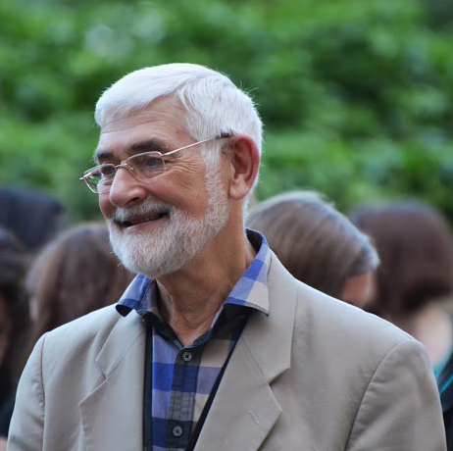
Penn Treebank
Treebank: a treebank is a parsed text corpus that annotates syntactic or semantic sentence structure.
Penn Treebank: Penn Treebank project has produced treebanks from the Brown, Switchboard, ATIS, and Wall Street Journal corpora of English, as well as treebanks in Arabic and Chinese
Treebank I (Marcus et al., 1993)
Treebank II (Marcus et al., 1994)
Treebank III releases of English treebanks
Geoffrey Neil Leech (1936 – 2014) was a specialist in English language and linguistics. He was the author, co-author, or editor of over 30 books and over 120 published papers. His main academic interests were English grammar, corpus linguistics, stylistics, pragmatics, and semantics. The term treebank, now generally applied to a parsed corpus, was coined by Leech in the 1980s.
Notes:
Treebank 是一个解析的文本语料库，用于注释句法或语义句子结构。杰弗里·尼尔·里奇
Penn Treebank 项目已经从 Brown、Switchboard、ATIS 和 Wall Street Journal 的英文语料库以及阿拉伯语和中文的树库中生成了树

Slide 26
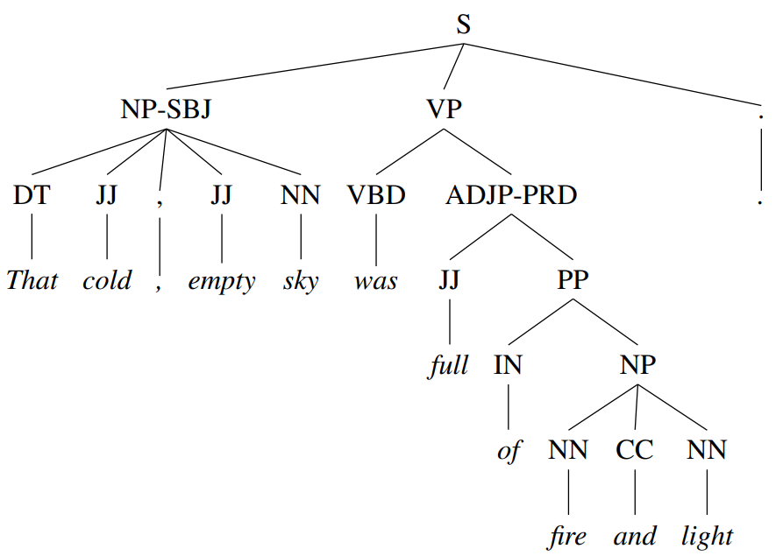
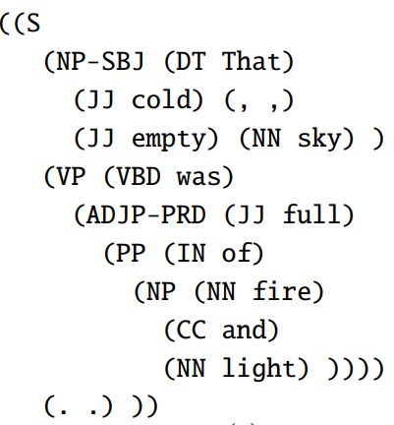
Penn Treebank - Example
Example: That cold, empty sky was full of fire and light.
Bracketed notation

Slide 27
Outline
Constituency Grammars
Constituency Parsing
Ambiguity
Notes:
成分分析Why constituency parsing? Ambiguity is the most serious problem faced by syntactic parsers.
歧义是句法解析器面临的最严重的问题。

Slide 28
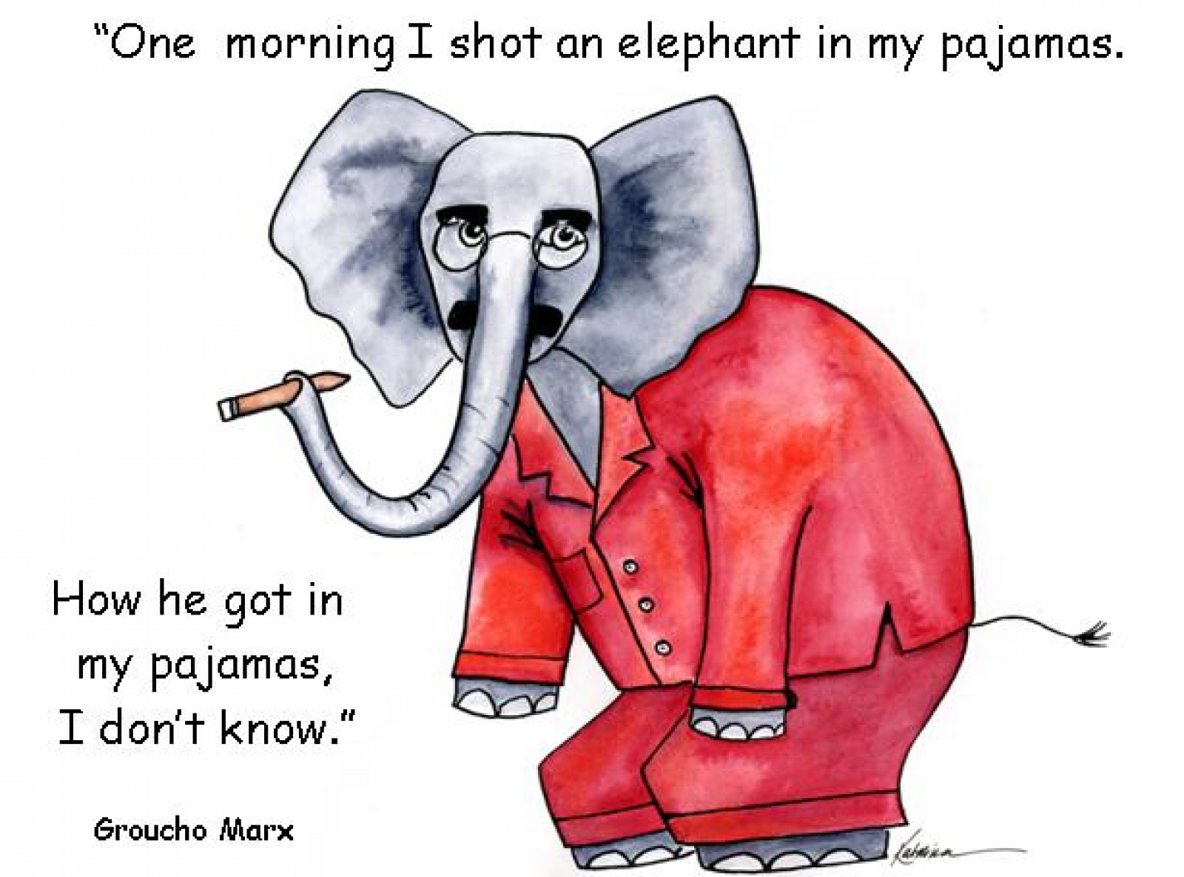

A joke
[Groucho Marx, Animal Crackers, 1930]: “One morning I shot an elephant in my pajamas. How he got into my pajamas I don’t know.”
I shot an elephant in my pajamas.
Pics are from web.[1] [2]
Notes:
One morning I shot an elephant in my pajamas. How he got into my pajamas I don’t know. 一天早上，我开枪了（一头穿着睡衣的大象）。 我不知道他是怎么穿上我的睡衣的。
一天早上，我穿着睡衣射杀了一头大象。 我不知道他是怎么穿上我的睡衣的。

Slide 29
Two parse trees for an ambiguous sentence
An ambiguous sentence: I shot an elephant in my pajamas
S
S
NP
VP
NP
VP
Pro
Verb
NP
Pro
VP
PP
I
shot
Det
Nominal
I
Verb
NP
in my pajamas
an
Nominal
PP
shot
Det
Nominal
Noun
in my pajamas
an
Noun
elephant
elephant
Notes:
A generative grammar is a traditional name in linguistics for a formal language that is used to model the grammar of a natural language.
One morning I [shot an elephant] in my pajamas. 一天早上，我穿着睡衣射杀了一头大象。

Slide 30
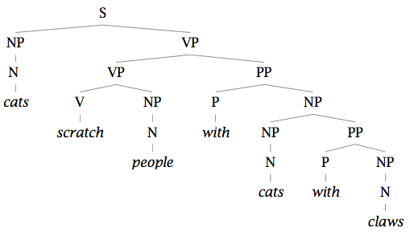
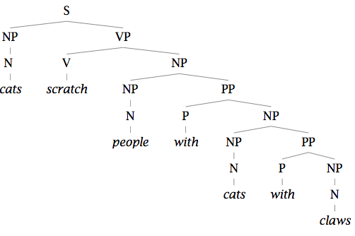
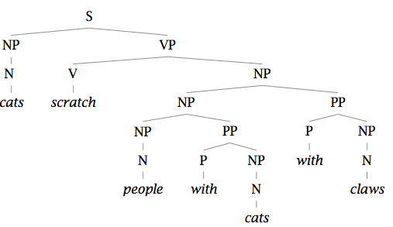
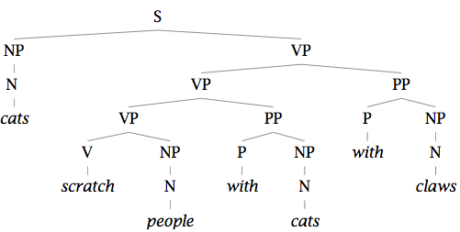
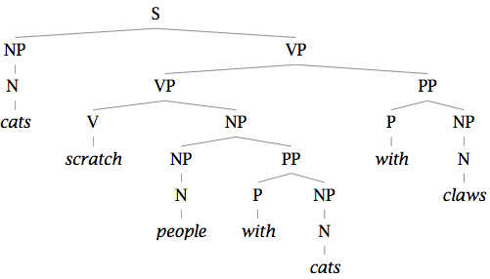
Many parses
Example: Cats scratch people with cats with claws
It has at least 5 different parses!
Notes:
例子：猫用爪子抓人 "Cats scratch people with cats with claws" 在中文中的翻译可能引起一些困惑，因为这句话在英文中本身就有一些歧义。这可能表示“带有爪子的猫用带有爪子的猫刮人”，这在逻辑上不太合理，或者表示“带有爪子的猫刮人”，这在逻辑上更合理。所以，这句话的翻译可能是“带有爪子的猫刮人”。然而，如果你确实想表达前面的意思，那么这句话的翻译可能是“带有爪子的猫用带有爪子的猫刮人”。
当你有一些规则后，可以有多个推导

Slide 31
Structural Ambiguity - Attachment ambiguity
A sentence has an attachment ambiguity if a particular constituent can be attached to the parse tree in more than one place.
PP-attachment ambiguity:
I shot [an elephant in my pajamas]
I [shot an elephant] in my pajamas
Adverbial phrases (AP)-attachment ambiguity
We saw [the Oriental Pearl Tower flying to Shanghai]
We saw [the Oriental Pearl Tower] flying to Shanghai
Others …
Notes:
结构歧义：有两个主要的ambiguity。第一个：如果特定成分可以在多个位置附加到分析树，则句子具有附加歧义。
1)介词短语的附着/依附歧义; 2) 状语短语（AP）--附件歧义
For instance, in the following example the gerundive-VP “flying to Paris” can be part of a gerundive sentence whose subject is the Eiffel Tower or it can be an adjunct modifying the VP headed by “saw”: “We saw the Eiffel Tower flying to Paris”. 例如，在下面的例子中，动名词副词“flying to Paris”可以是主语是埃菲尔铁塔的动名词句子的一部分，也可以是修饰以“saw”为首的副词的副词：“We saw the Eiffel Tower 飞往巴黎”。
Various kinds of adverbial phrases are also subject to this kind of ambiguity. 各种状语短语也受制于这种歧义。

Slide 32
Structural Ambiguity - Coordination ambiguity
In coordination ambiguity, phrases can be conjoined by a conjunction like and
Examples:
The phrase, “old men and women”
[old [men and women]], referring to old men and old women
[old men] and [women], in which case it is only the men who are old
Other structural ambiguity
Noun-phrase bracketing ambiguity: “crude oil prices” whether the phrase is stating “crude prices” (crude (oil prices)) or “crude oil” ((crude oil) prices)
Notes:
并列歧义; 在协调中，歧义短语可以由连接词和连接。
其他的一些歧义
实际中，存在许多语法正确但语义不合理的解析，一个合理的解析器需要解决这些问题。 幸运的是，CKY 算法可以有效地处理结构歧义。 我们也可以使用神经方法来增强 CKY，以通过句法消歧来选择单个正确的解析。

Slide 33
Outline
Constituency Grammars
Constituency Parsing
Ambiguity
CKY Parsing
Notes:
成分分析

Slide 34
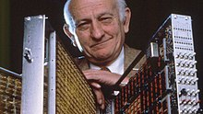
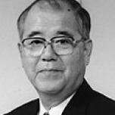
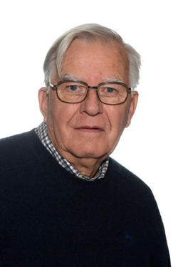
CKY Parsing
Cocke-Kasami-Younger (CKY) algorithm, the most widely used dynamic-programming based approach to parsing.
It is a parsing algorithm for context-free grammars published by Itiroo Sakai in 1961. It is named after some of its rediscoverers: John Cocke, Daniel Younger, Tadao Kasami, and Jacob T. Schwartz.
John Cocke (1925 – 2002) was an American computer scientist recognized for his large contribution to computer architecture and optimizing compiler design. (1970)
Tadao Kasami (嵩忠雄 1930 – 2007) was a noted Japanese information theorist who made significant contributions to error correcting codes. He was the earliest to publish the key ideas for the CYK algorithm. (1965)
Daniel Younger was educated at Columbia University, as undergraduate and graduate student, culminating in a PhD in 1963. His Thesis was entitled "Feedback in a Directed Graph." He continued the next year work on Directed Graphs as a Postdoctoral Fellow at Princeton University. (1967)
Notes:
Cocke-Kasami-Younger (CKY) 算法，最广泛使用的基于动态规划的解析方法。
它是由 Itiroo Sakai 于 1961 年发布的上下文无关语法的解析算法。它以一些重新发现者的名字命名：John Cocke、Daniel Younger、Tadao Kasami 和 Jacob T. Schwartz。
Daniel Younger, He retired his full time position in 2005, University of Waterloo 滑铁卢大学

Slide 35
Applications of CKY algorithm
The CKY algorithm can be used to compute many interesting things.
Here we use it to solve the following tasks:
Recognition: Is there any parse tree at all?
Probabilistic parsing: What is the most probable parse tree?
Notes:
CKY 算法可用于计算许多有趣的事情。
需要解决两个基本问题

Slide 36
CKY Parsing
CNF grammar: CKY algorithm requires grammars to first be in Chomsky Normal Form (CNF)
Grammars in CNF are restricted to rules of the form A → BC or A → w
CKY Recognition: A two-dimensional matrix can be used to encode the structure of an entire tree
CKY Parsing: to tell which one is correct, use span-based constituency parsing
Notes:
CKY 算法要求文法首先是乔姆斯基范式 (CNF)
二维矩阵可用于对整个树的结构进行编码。
要判断哪个是正确的，请使用基于跨度的选区解析

Slide 37
Outline
Constituency Grammars
Constituency Parsing
Ambiguity
CKY Parsing
Convert to CNF grammar
Notes:
成分分析

Slide 38
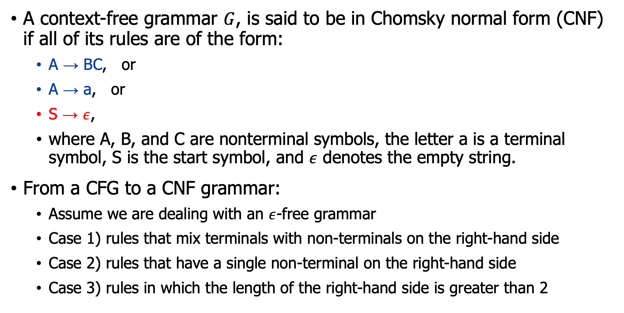
CNF grammar
A context-free grammar $G$, is said to be in Chomsky normal form (CNF) if all of its rules are of the form:
A → BC, or
A → a, or
S → $ε$,
where A, B, and C are nonterminal symbols, the letter a is a terminal symbol, S is the start symbol, and $ε$ denotes the empty string.
From a CFG to a CNF grammar:
Assume we are dealing with an $ε$-free grammar
Case 1) rules that mix terminals with non-terminals on the right-hand side
Case 2) rules that have a single non-terminal on the right-hand side
Case 3) rules in which the length of the right-hand side is greater than 2
Notes:
回顾一下：一个上下文无关文法 𝐺，如果其所有规则都具有以下形式，则称其为乔姆斯基范式 (CNF)
假设我们正在处理一个没有𝜖的语法
1) 将终端与右侧的非终端混合的规则; 2) 右侧只有一个非终结符的规则; 3) 右手边长度大于 2 的规则

Slide 39
1) Dealing with rules like A → aB
The remedy for rules that mix terminals and non-terminals is to simply introduce a new dummy non-terminal that covers only the original terminal.
A → aB would be replaced by tow rules: A → A₁B, A₁ → a
INF-VP → to VP would be replaced by the two rules INF-VP → TO VP, TO → to
Two above examples, A₁ and TO are new dummy non-terminals.
Notes:
混合终结符和非终结符规则的补救措施是：简单地引入一个新的虚拟非终结符，它只覆盖原始终结符。

Slide 40
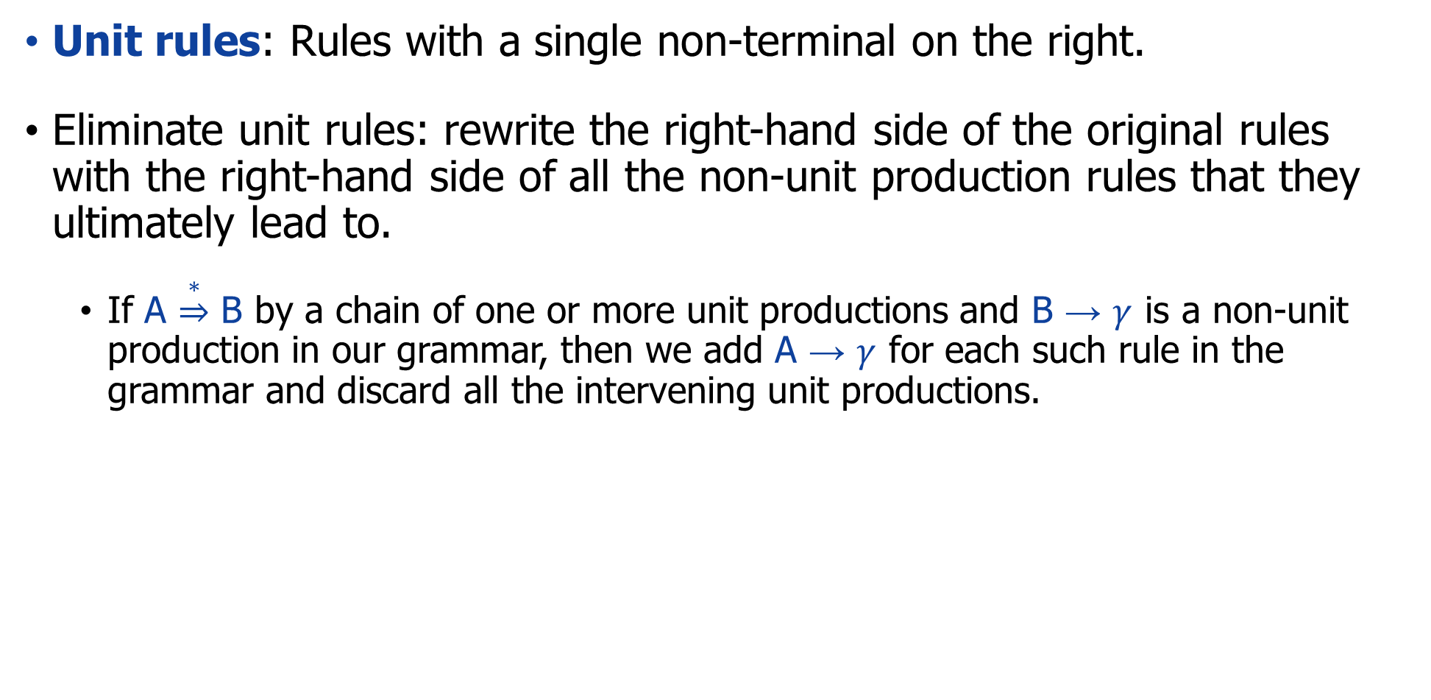
2) Dealing with rules like A → B
Unit rules: Rules with a single non-terminal on the right.
Eliminate unit rules: rewrite the right-hand side of the original rules with the right-hand side of all the non-unit production rules that they ultimately lead to.
If A $\underset{⇒}{∗}$ B by a chain of one or more unit productions and B → $γ$ is a non-unit production in our grammar, then we add A → $γ$ for each such rule in the grammar and discard all the intervening unit productions.

Slide 41
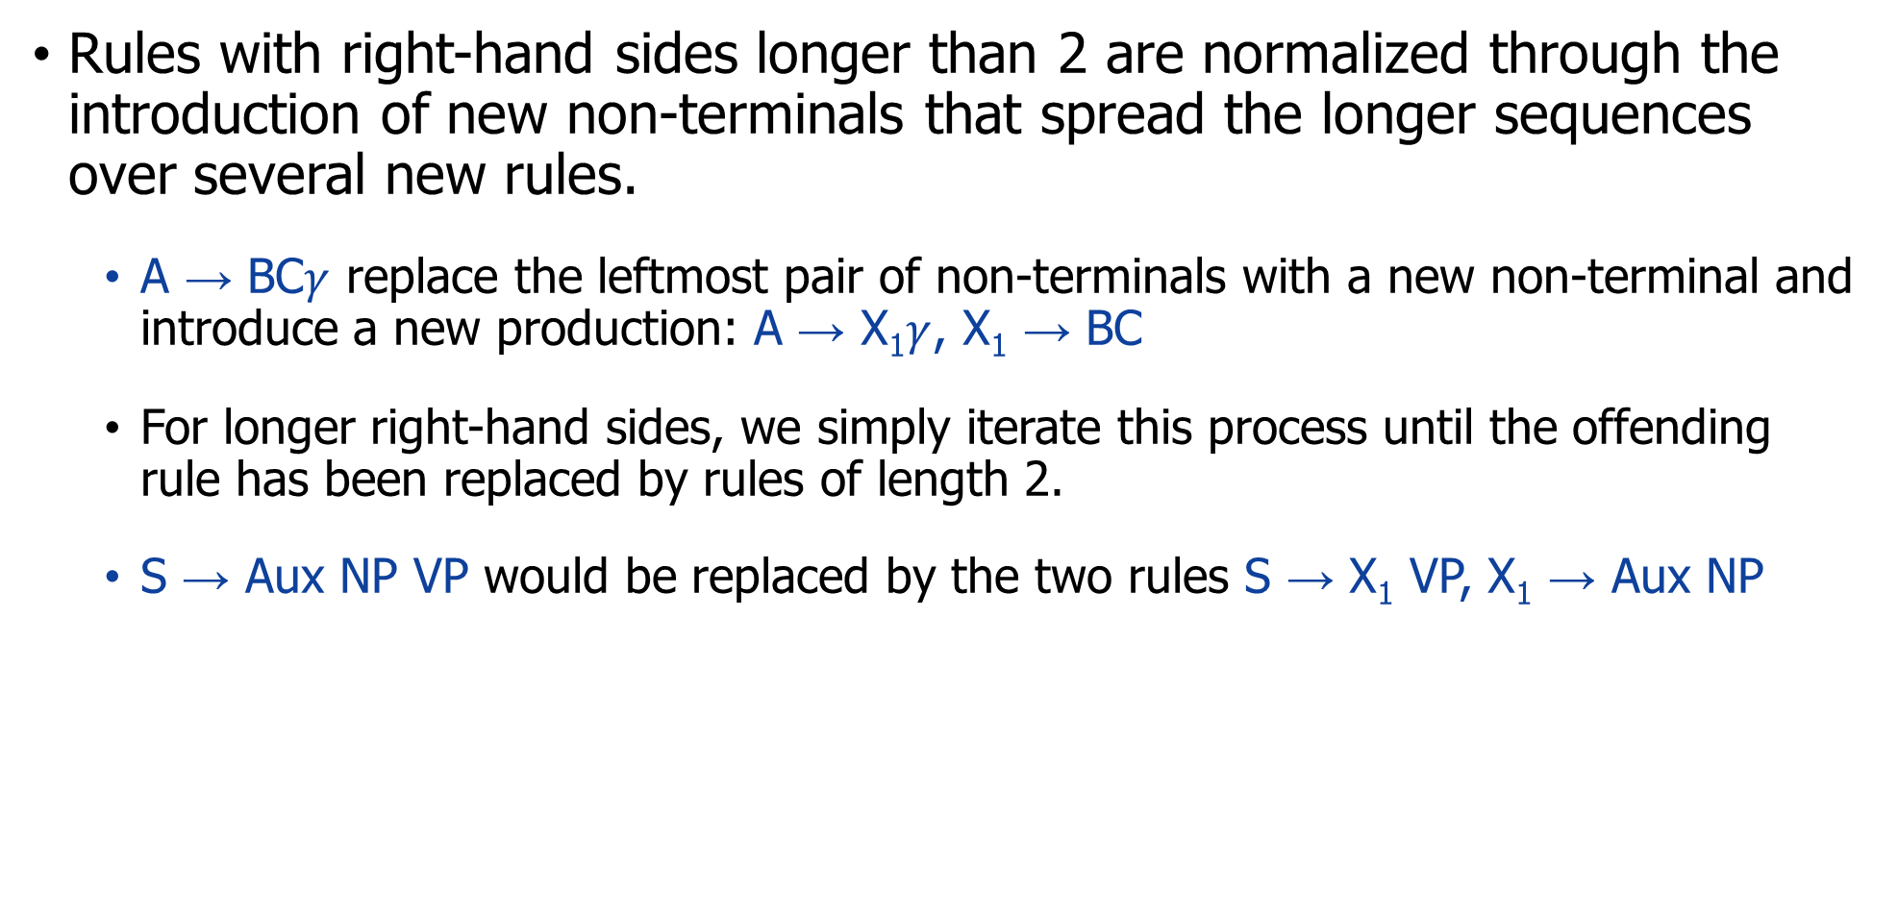
3) Dealing with rules like A → BCD
Rules with right-hand sides longer than 2 are normalized through the introduction of new non-terminals that spread the longer sequences over several new rules.
A → BC$γ$ replace the leftmost pair of non-terminals with a new non-terminal and introduce a new production: A → X₁$γ$, X₁ → BC
For longer right-hand sides, we simply iterate this process until the offending rule has been replaced by rules of length 2.
S → Aux NP VP would be replaced by the two rules S → X₁ VP, X₁ → Aux NP

Slide 42
Before and after binarization
S
S
NP
VP
NP
VP
V
NP
N
V
@VP_V
PP
N
people
fish
N
P
NP
people
fish
NP
PP
N
NP
N
P
tanks
with
rods
N
tanks
with
rods
Notes:
通过上面三个方式，可以得到二叉树。

Slide 43
Entire conversion process
1) Copy all conforming rules to the new grammar unchanged.
2) Convert terminals within rules to dummy non-terminals.
3) Convert unit rules.
4) Make all rules binary and add them to new grammar.

Slide 44
Real example: miniature English grammar
Grammar Lexicon
S → NP VP Det → that | this | the | a
S → Aux NP VP Noun → book | flight | meal | money
S → VP Verb → book | include | prefer
NP → Pronoun Pronoun → I | she | me
NP → Proper-Noun Proper-Noun → Houston | NWA
NP → Det Nominal Aux → does
Nominal → Noun Preposition → from | to | on | near | through
Nominal → Nominal Noun
Nominal → Nominal PP
VP → Verb
VP → Verb NP
VP → Verb NP PP
VP → Verb PP
VP → VP PP
PP → Preposition NP
Task: convert this grammar to CNF

Slide 45
1) Copy all conforming rules
Grammar Lexicon
Det → that | this | the | a
Noun → book | flight | meal | money
Verb → book | include | prefer
Pronoun → I | she | me
Proper-Noun → Houston | NWA
Aux → does
Preposition → from | to | on | near | through
S → NP VP
NP → Det Nominal
Nominal → Nominal Noun
Nominal → Nominal PP
VP → Verb NP
VP → Verb PP
VP → VP PP
PP → Preposition NP
S → Aux NP VP
S → VP
NP → Pronoun
NP → Proper-Noun
Nominal → Noun
VP → Verb
VP → Verb NP PP
Rules need to process further:

Slide 46
2) Convert terminals
No terminals in rules. Skip

Slide 47
3) Convert unit rules
S → NP VP
S → Aux NP VP
S → VP
NP → Pronoun
NP → Proper-Noun
NP → Det Nominal
Nominal → Noun
Nominal → Nominal Noun
Nominal → Nominal PP
VP → Verb
VP → Verb NP
VP → Verb NP PP
VP → Verb PP
VP → VP PP
PP → Preposition NP
Det → that | this | the | a
Noun → book | flight | meal | money
Verb → book | include | prefer
Pronoun → I | she | me
Proper-Noun → Houston | NWA
Aux → does
Preposition → from | to | on | near | through
S → VP, VP → Verb, new rules: S → book | include | prefer
S → VP, VP → Verb NP, new rules: S → Verb NP
S → VP, VP → Verb NP PP, then new rules: S → Verb NP PP
S → VP, VP → Verb PP, new rules: S → Verb PP
S → VP, VP → VP PP, then new rules: S → VP PP
NP → Pronoun, new rules: NP → I | she | me
NP → Proper-Noun, new rules: NP → Houston | NWA
Nominal → Noun, new rules: NP → book | flight | meal | money
VP → Verb, then new rules: S → book | include | prefer

Slide 48
4) Make all rules binary
Copied rules
S → NP VP
NP → Det Nominal
Nominal → Nominal Noun
Nominal → Nominal PP
VP → Verb NP
VP → Verb PP
VP → VP PP
PP → Preposition NP
Det → that | this | the | a
Noun → book | flight | meal | money
Verb → book | include | prefer
Pronoun → I | she | me
Proper-Noun → Houston | NWA
Aux → does
Preposition → from | to | on | near | through
New rules
Unprocessed rules
S → book | include | prefer
S → Verb NP
S → Verb NP PP
S → Verb PP
S → VP PP
NP → I | she | me
NP → Houston | NWA
NP → book | flight | meal | money
S → book | include | prefer
S → Aux NP VP
Two new dummies:
X1 → Aux NP
X2 → Verb NP

Slide 49
Final rules
S → NP VP
S → Aux NP VP
S → VP
NP → Pronoun
NP → Proper-Noun
NP → Det Nominal
Nominal → Noun
Nominal → Nominal Noun
Nominal → Nominal PP
VP → Verb
VP → Verb NP
VP → Verb NP PP
VP → Verb PP
VP → VP PP
PP → Preposition NP
Nominal → book | flight | meal | money
Nominal → Nominal Noun
Nominal → Nominal PP
Nominal → Nominal PP
VP → book | include | prefer
VP → Verb NP
VP → X2 PP
X2 → Verb NP
VP → Verb PP
VP → VP PP
VP → VP PP
PP → Preposition NP
S → NP VP
S → X1 VP
X1 → Aux NP
S → book | include | prefer
S → Verb NP
S → X2 PP
S → Verb PP
S → VP PP
NP → I | she | me
NP → TWA | Houston
NP → Det Nominal
Det → that | this | the | a
Noun → book | flight | meal | money
Verb → book | include | prefer
Pronoun → I | she | me
Proper-Noun → Houston | NWA
Aux → does
Preposition → from | to | on | near | through

Slide 50
Outline
Constituency Grammars
Constituency Parsing
Ambiguity
CKY Parsing
Convert to CNF grammar
Recognizer
Notes:
成分分析

Slide 51
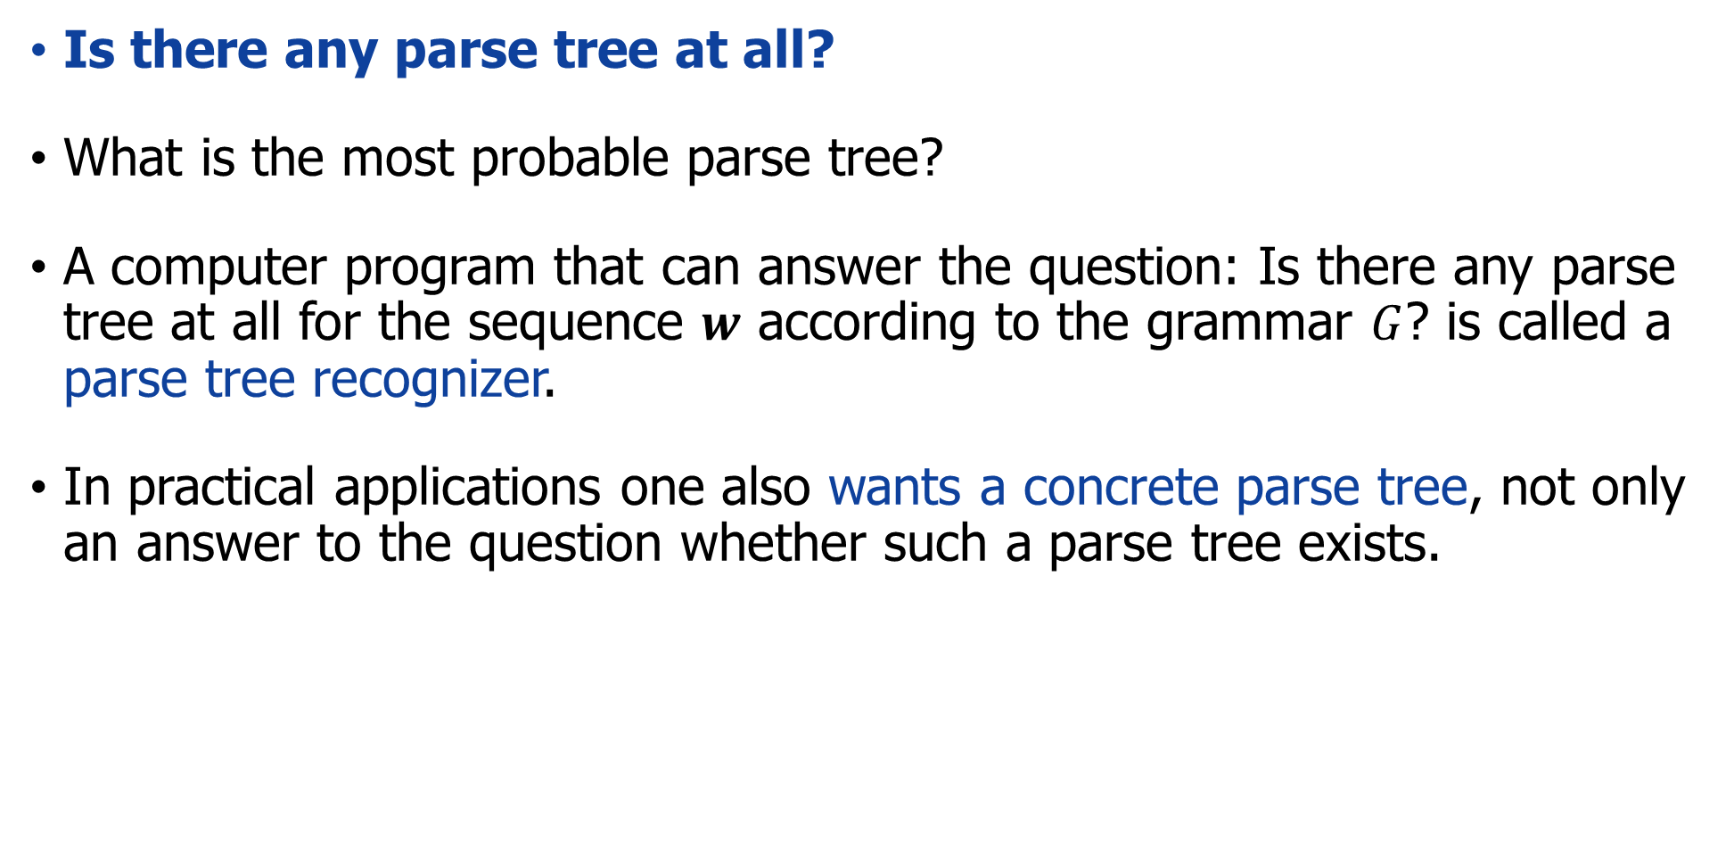
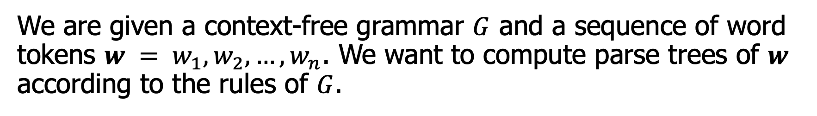
Structure of $w$ and parse tree recognizer
Is there any parse tree at all?
What is the most probable parse tree?
A computer program that can answer the question: Is there any parse tree at all for the sequence $w$ according to the grammar $G$? is called a parse tree recognizer.
In practical applications one also wants a concrete parse tree, not only an answer to the question whether such a parse tree exists.
We are given a context-free grammar $G$ and a sequence of word tokens $w = w_{1}, w_{2},…,w_{n}$. We want to compute parse trees of $w$ according to the rules of $G$.

Slide 52
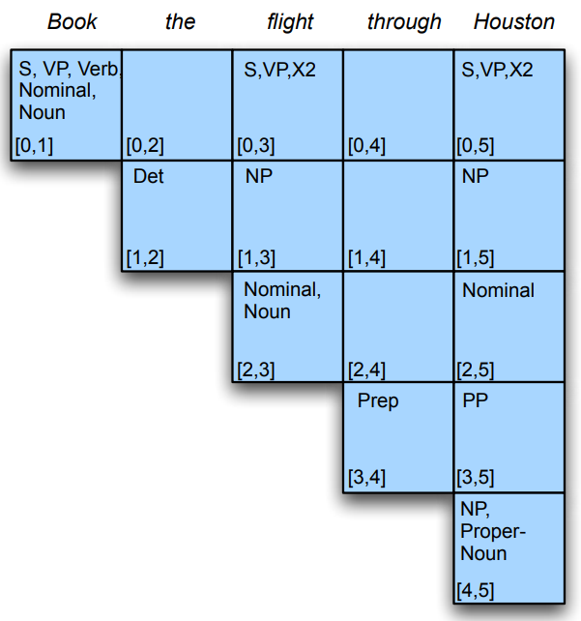
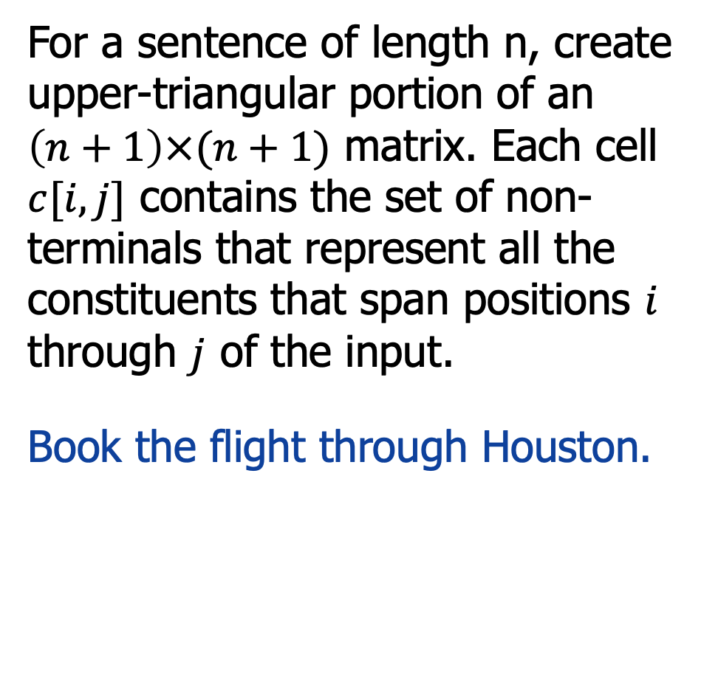
CKY Recognition
For a sentence of length n, create upper-triangular portion of an $\left(n+1\right)×(n+1)$ matrix. Each cell $c[i,j]$ contains the set of non-terminals that represent all the constituents that span positions $i$ through $j$ of the input.
Book the flight through Houston.
S → book
VP → book
Verb → book
Nominal → book
Noun → book
Notes:
我首先找到那些指向book的规则对应有哪些非终结符。

Slide 53
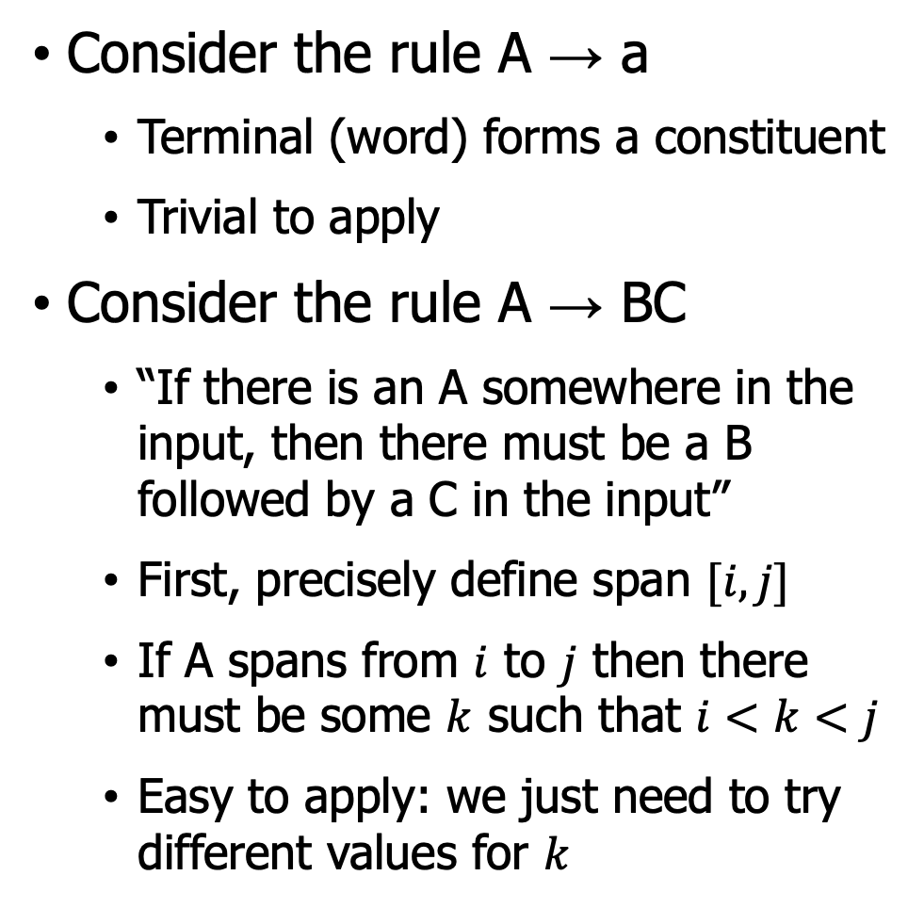
CKY Algorithm: Intuition
Consider the rule A → a
Terminal (word) forms a constituent
Trivial to apply
Consider the rule A → BC
“If there is an A somewhere in the input, then there must be a B followed by a C in the input”
First, precisely define span $[i,j]$
If A spans from $i$ to $j$ then there must be some $k$ such that $i<k<j$
Easy to apply: we just need to try different values for $k$
A
B
C
Notes:
简单的规则
复杂的规则：
“如果输入中某处有一个 A，那么输入中必须有一个 B，后跟一个 C”
定义

Slide 54
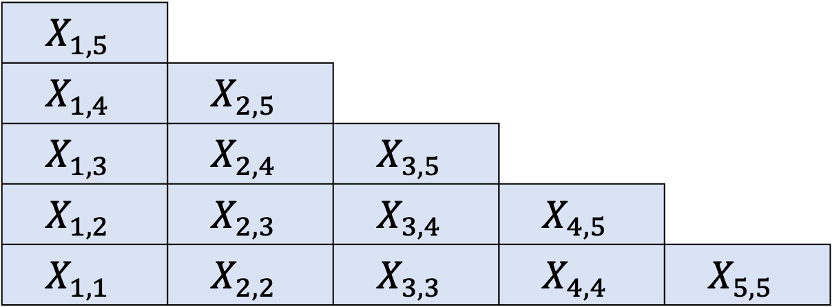
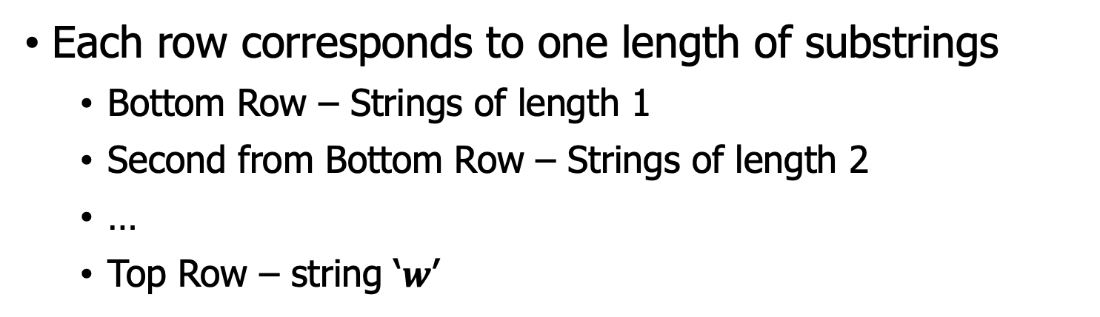
Construct a Triangular Table
Each row corresponds to one length of substrings
Bottom Row – Strings of length 1
Second from Bottom Row – Strings of length 2
…
Top Row – string ‘$w$’
$$X_{1,5}$$
$$X_{1,4}$$ | $$X_{2,5}$$
$$X_{1,3}$$ | $$X_{2,4}$$ | $$X_{3,5}$$
$$X_{1,2}$$ | $$X_{2,3}$$ | $$X_{3,4}$$ | $$X_{4,5}$$
$$X_{1,1}$$ | $$X_{2,2}$$ | $$X_{3,3}$$ | $$X_{4,4}$$ | $$X_{5,5}$$
Consider string w = baaba

Slide 55
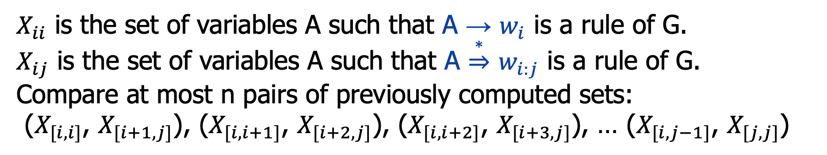
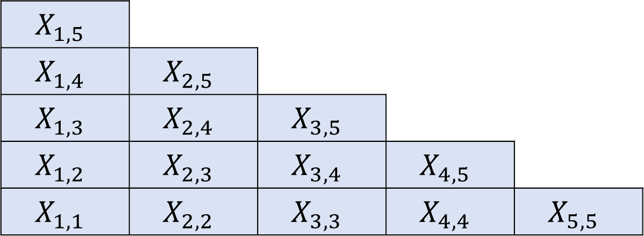
Construct a Triangular Table
$X_{ii}$ is the set of variables A such that A → $w_{i}$ is a rule of G.
$X_{ij}$ is the set of variables A such that A $\underset{⇒}{∗}$ $w_{i:j}$ is a rule of G.
Compare at most n pairs of previously computed sets:
($X_{[i,i]}$, $X_{[i+1,j]}$), ($X_{[i,i+1]}$, $X_{[i+2,j]}$), ($X_{[i,i+2]}$, $X_{[i+3,j]}$), … ($X_{[i, j−1]}$, $X_{[j,j]}$)
$$X_{1,5}$$
$$X_{1,4}$$ | $$X_{2,5}$$
$$X_{1,3}$$ | $$X_{2,4}$$ | $$X_{3,5}$$
$$X_{1,2}$$ | $$X_{2,3}$$ | $$X_{3,4}$$ | $$X_{4,5}$$
$$X_{1,1}$$ | $$X_{2,2}$$ | $$X_{3,3}$$ | $$X_{4,4}$$ | $$X_{5,5}$$
w = w1 w2 w3 w4 w5

Slide 56
Example CYK Algorithm
Show the CYK Algorithm with the following example:
CNF grammar of G:
S → AB | BC
A → BA | a
B → CC | b
C → AB | a
Input string: baaba
Question: Is baaba in L(G)?

Slide 57
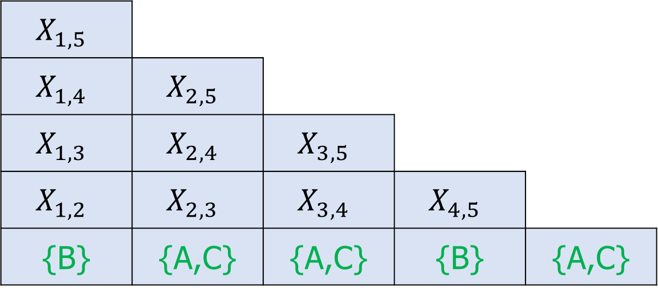
Constructing The Triangular Table
Calculating the Bottom ROW
S → AB | BC
A → BA | a
B → CC | b
C → AB | a
$$X_{1,5}$$
$$X_{1,4}$$ | $$X_{2,5}$$
$$X_{1,3}$$ | $$X_{2,4}$$ | $$X_{3,5}$$
$$X_{1,2}$$ | $$X_{2,3}$$ | $$X_{3,4}$$ | $$X_{4,5}$$
{B} | {A,C} | {A,C} | {B} | {A,C}
w = b a a b a

Slide 58
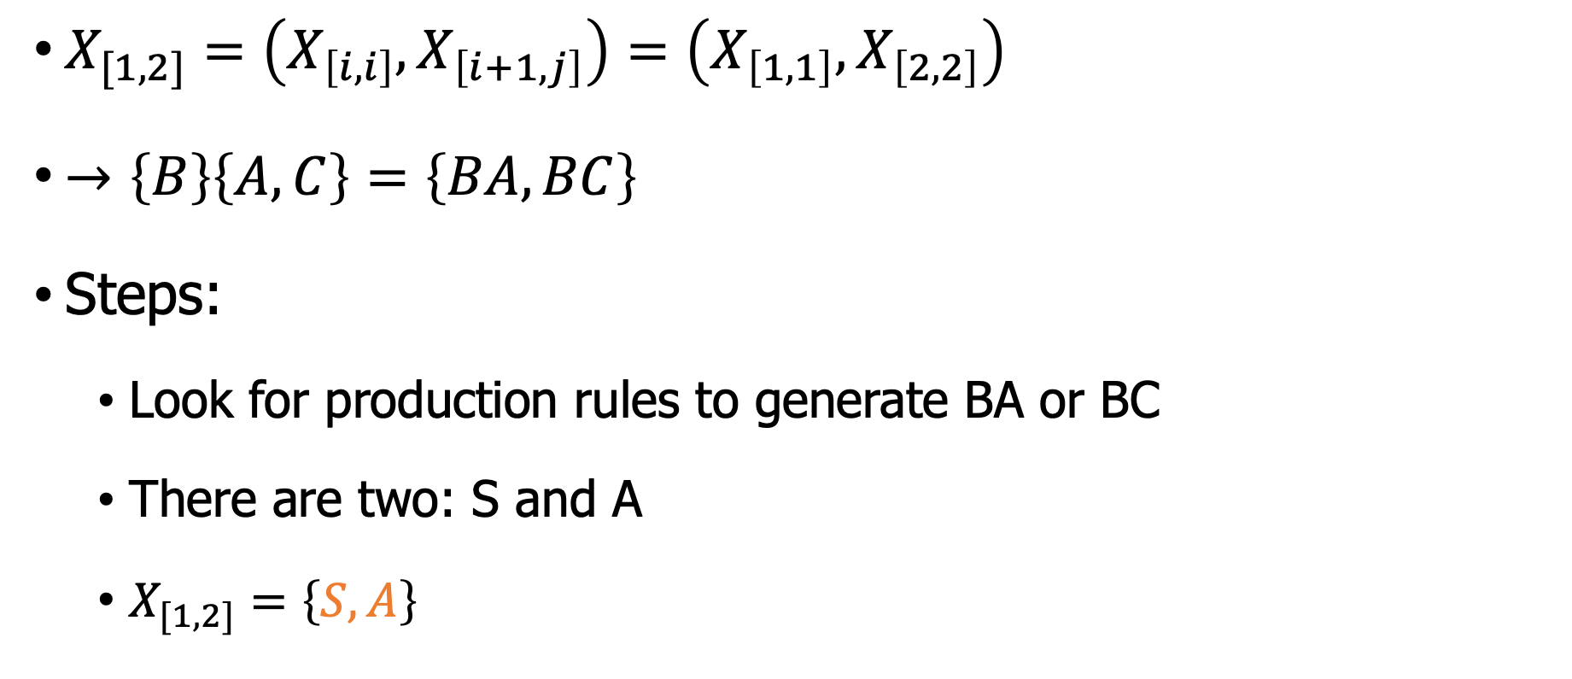
Constructing The Triangular Table
S → AB | BC
A → BA | a
B → CC | b
C → AB | a
$X_{[1,2]}=\left(X_{\left[i,i\right]},X_{\left[i+1,j\right]}\right)=\left(X_{\left[1,1\right]},X_{\left[2,2\right]}\right)$
$→\left\{B\right\}\left\{A,C\right\}=\left\{BA,BC\right\}$
Steps:
Look for production rules to generate BA or BC
There are two: S and A
$X_{[1,2]}=\left\{S,A\right\}$

Slide 59
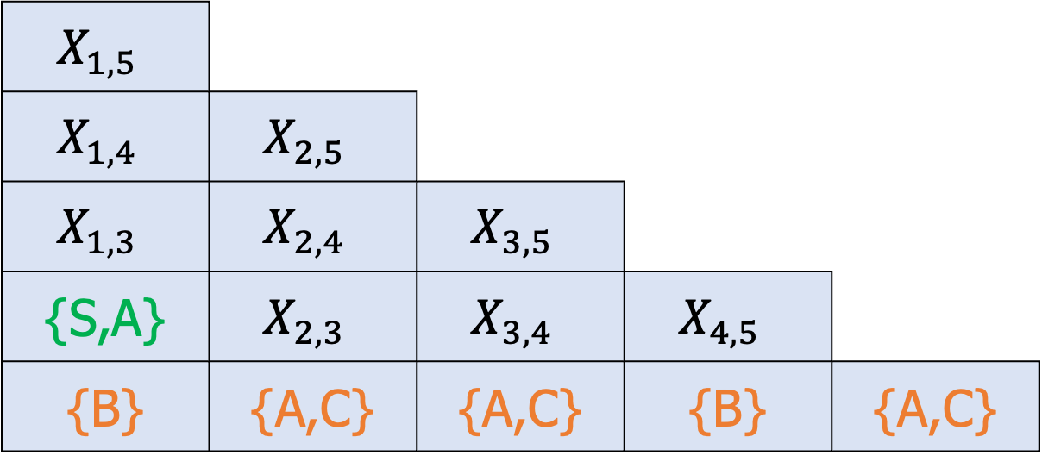
Constructing The Triangular Table
Calculated cell [1,2]
S → AB | BC
A → BA | a
B → CC | b
C → AB | a
$$X_{1,5}$$
$$X_{1,4}$$ | $$X_{2,5}$$
$$X_{1,3}$$ | $$X_{2,4}$$ | $$X_{3,5}$$
{S,A} | $$X_{2,3}$$ | $$X_{3,4}$$ | $$X_{4,5}$$
{B} | {A,C} | {A,C} | {B} | {A,C}
w = b a a b a

Slide 60
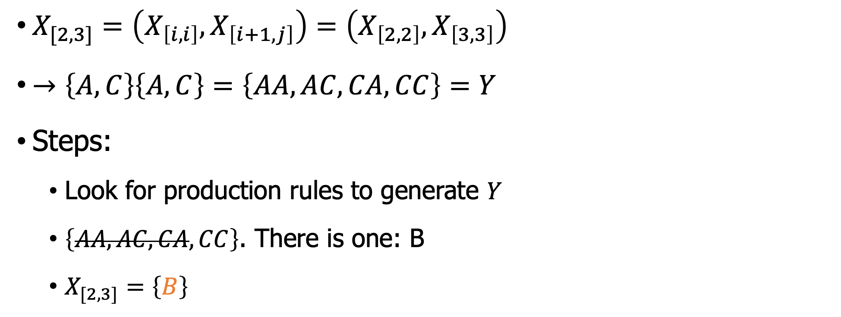
Constructing The Triangular Table
$X_{[2,3]}=\left(X_{\left[i,i\right]},X_{\left[i+1,j\right]}\right)=\left(X_{\left[2,2\right]},X_{\left[3,3\right]}\right)$
$→\left\{A,C\right\}\left\{A,C\right\}=\left\{AA,AC,CA,CC\right\}=Y$
Steps:
Look for production rules to generate $Y$
$\left\{AA,AC,CA,CC\right\}$. There is one: B
$X_{[2,3]}=\left\{B\right\}$
S → AB | BC
A → BA | a
B → CC | b
C → AB | a

Slide 61
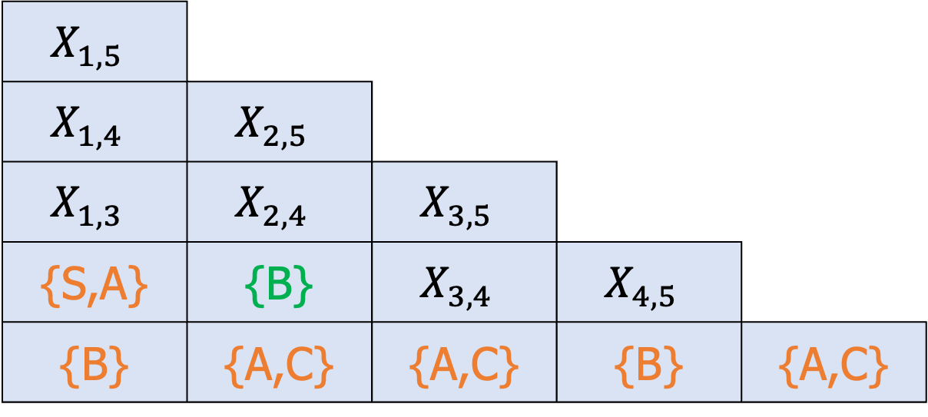
Constructing The Triangular Table
Calculated cell [2,3]
S → AB | BC
A → BA | a
B → CC | b
C → AB | a
$$X_{1,5}$$
$$X_{1,4}$$ | $$X_{2,5}$$
$$X_{1,3}$$ | $$X_{2,4}$$ | $$X_{3,5}$$
{S,A} | {B} | $$X_{3,4}$$ | $$X_{4,5}$$
{B} | {A,C} | {A,C} | {B} | {A,C}
w = b a a b a

Slide 62
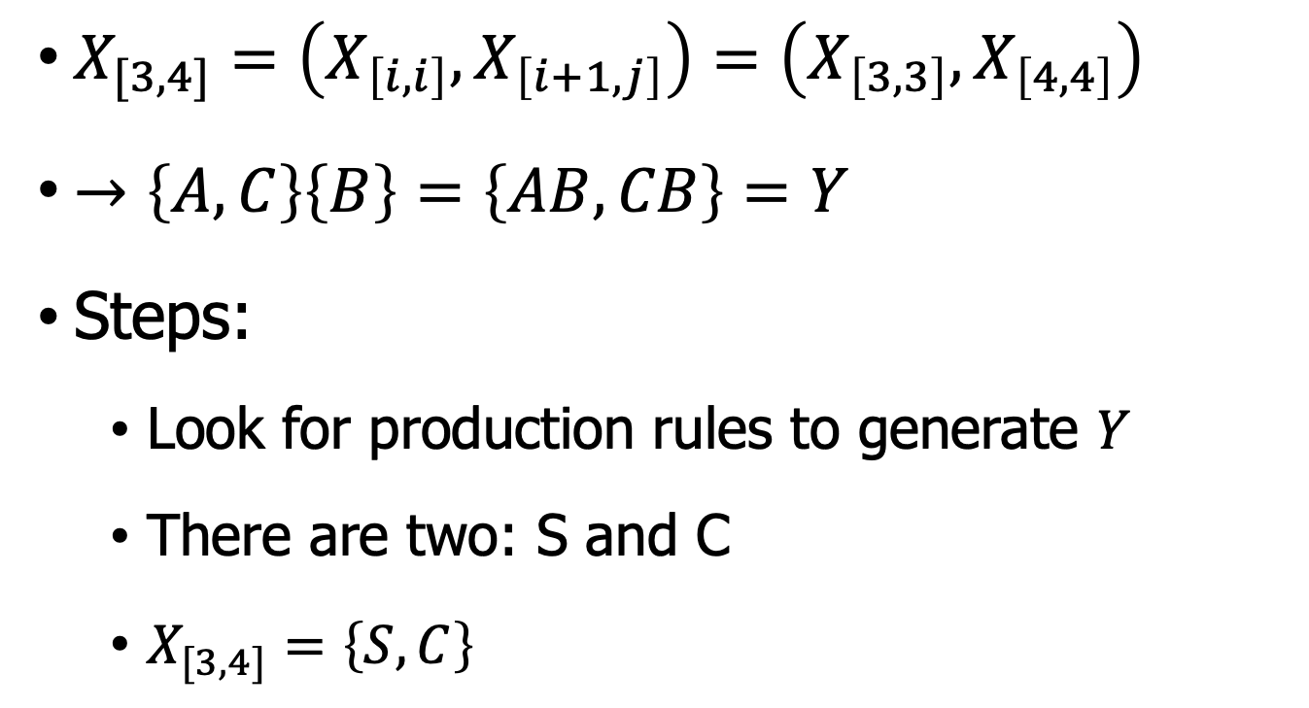
Constructing The Triangular Table
$X_{[3,4]}=\left(X_{\left[i,i\right]},X_{\left[i+1,j\right]}\right)=\left(X_{\left[3,3\right]},X_{\left[4,4\right]}\right)$
$→\left\{A,C\right\}\left\{B\right\}=\left\{AB, CB\right\}=Y$
Steps:
Look for production rules to generate $Y$
There are two: S and C
$X_{[3,4]}=\left\{S,C\right\}$
S → AB | BC
A → BA | a
B → CC | b
C → AB | a

Slide 63
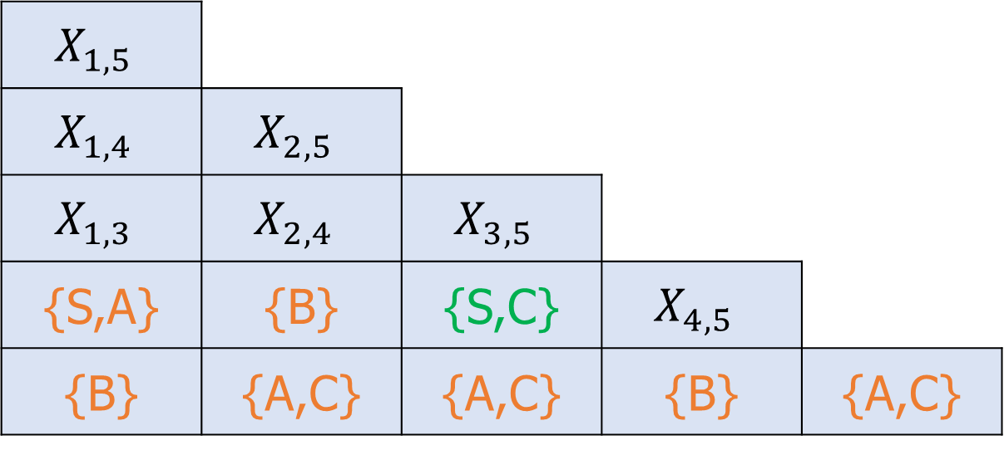
Constructing The Triangular Table
S → AB | BC
A → BA | a
B → CC | b
C → AB | a
Calculated cell [3,4]
$$X_{1,5}$$
$$X_{1,4}$$ | $$X_{2,5}$$
$$X_{1,3}$$ | $$X_{2,4}$$ | $$X_{3,5}$$
{S,A} | {B} | {S,C} | $$X_{4,5}$$
{B} | {A,C} | {A,C} | {B} | {A,C}
w = b a a b a

Slide 64
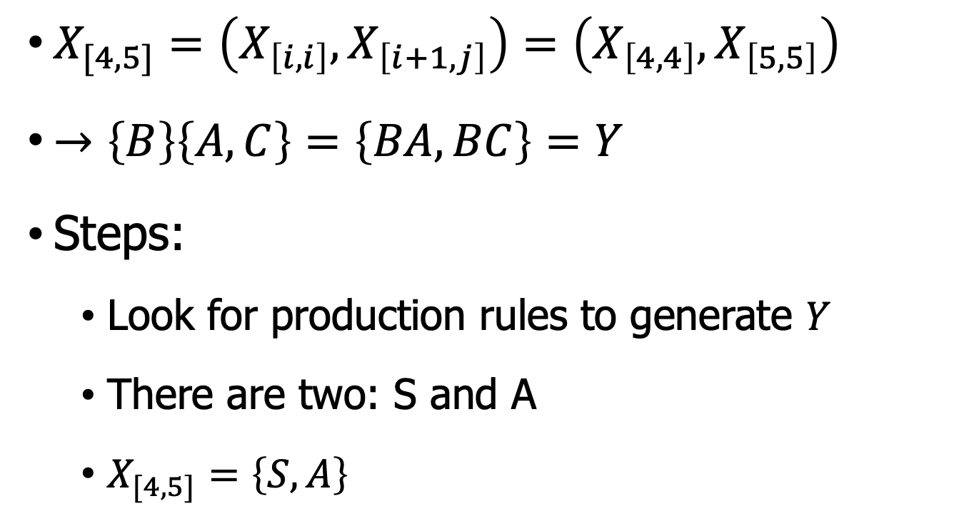
Constructing The Triangular Table
$X_{[4,5]}=\left(X_{\left[i,i\right]},X_{\left[i+1,j\right]}\right)=\left(X_{\left[4,4\right]},X_{\left[5,5\right]}\right)$
$→\left\{B\right\}\left\{A,C\right\}=\left\{BA, BC\right\}=Y$
Steps:
Look for production rules to generate $Y$
There are two: S and A
$X_{[4,5]}=\left\{S,A\right\}$
S → AB | BC
A → BA | a
B → CC | b
C → AB | a

Slide 65
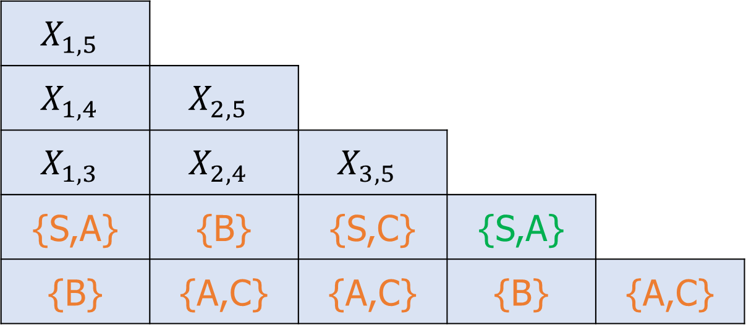
Constructing The Triangular Table
S → AB | BC
A → BA | a
B → CC | b
C → AB | a
Calculated cell [4,5]
$$X_{1,5}$$
$$X_{1,4}$$ | $$X_{2,5}$$
$$X_{1,3}$$ | $$X_{2,4}$$ | $$X_{3,5}$$
{S,A} | {B} | {S,C} | {S,A}
{B} | {A,C} | {A,C} | {B} | {A,C}
w = b a a b a

Slide 66
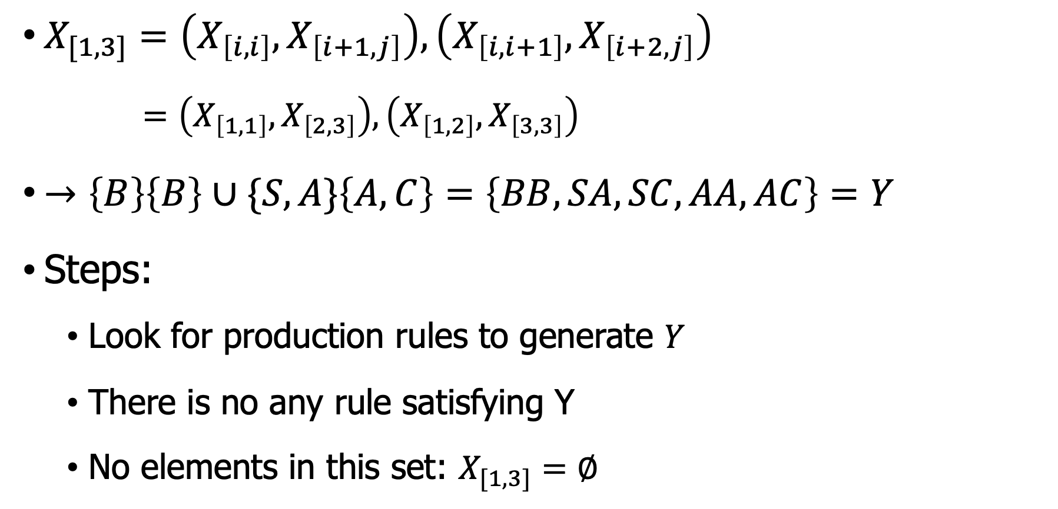
Constructing The Triangular Table
$X_{[1,3]}=\left(X_{\left[i,i\right]},X_{\left[i+1,j\right]}\right),\left(X_{\left[i,i+1\right]},X_{\left[i+2,j\right]}\right)$
$=\left(X_{\left[1,1\right]},X_{\left[2,3\right]}\right),\left(X_{\left[1,2\right]},X_{\left[3,3\right]}\right)$
$→\left\{B\right\}\left\{B\right\}∪\{S,A\}\left\{A,C\right\}=\left\{BB,SA, SC,AA,AC\right\}=Y$
Steps:
Look for production rules to generate $Y$
There is no any rule satisfying Y
No elements in this set: $X_{[1,3]}=∅$
S → AB | BC
A → BA | a
B → CC | b
C → AB | a

Slide 67
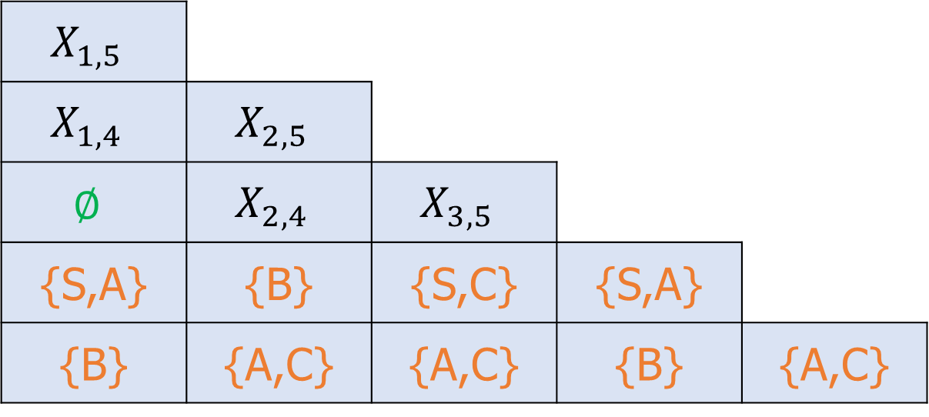
Constructing The Triangular Table
Calculated cell [1,3]
S → AB | BC
A → BA | a
B → CC | b
C → AB | a
$$X_{1,5}$$
$$X_{1,4}$$ | $$X_{2,5}$$
$$∅$$ | $$X_{2,4}$$ | $$X_{3,5}$$
{S,A} | {B} | {S,C} | {S,A}
{B} | {A,C} | {A,C} | {B} | {A,C}
w = b a a b a

Slide 68
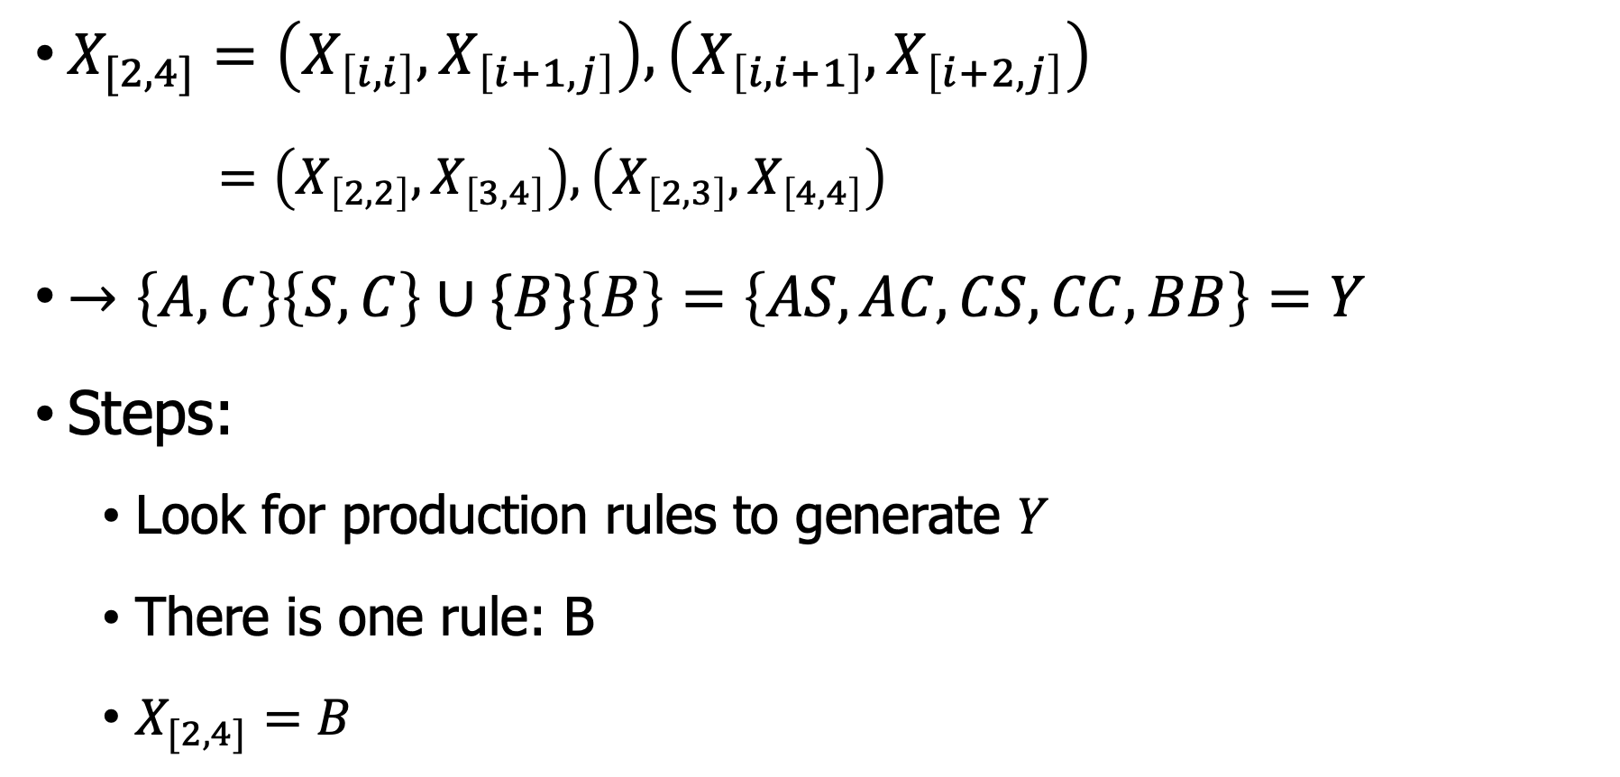
Constructing The Triangular Table
S → AB | BC
A → BA | a
B → CC | b
C → AB | a
$X_{[2,4]}=\left(X_{\left[i,i\right]},X_{\left[i+1,j\right]}\right),\left(X_{\left[i,i+1\right]},X_{\left[i+2,j\right]}\right)$
$=\left(X_{\left[2,2\right]},X_{\left[3,4\right]}\right),\left(X_{\left[2,3\right]},X_{\left[4,4\right]}\right)$
$→\left\{A,C\right\}\left\{S,C\right\}∪\{B\}\left\{B\right\}=\left\{AS, AC, CS,CC,BB\right\}=Y$
Steps:
Look for production rules to generate $Y$
There is one rule: B
$X_{[2,4]}=B$

Slide 69
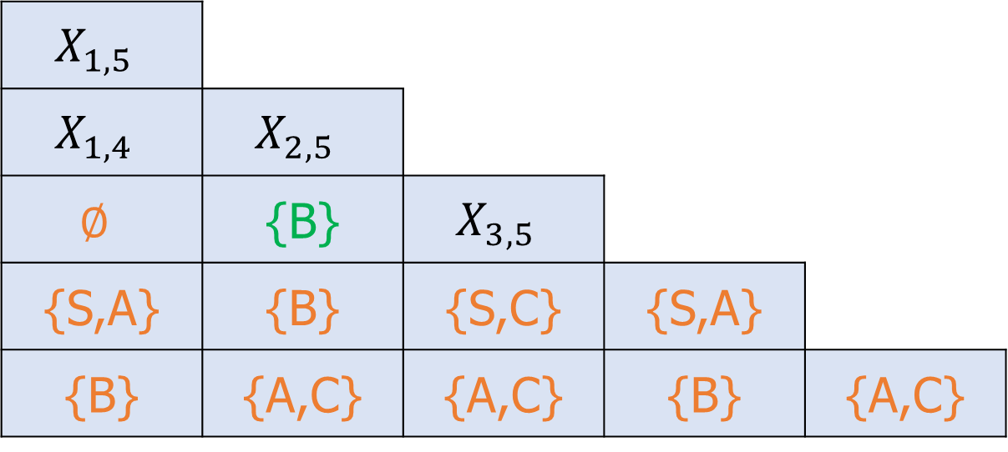
Constructing The Triangular Table
S → AB | BC
A → BA | a
B → CC | b
C → AB | a
Calculated cell [2,4]
$$X_{1,5}$$
$$X_{1,4}$$ | $$X_{2,5}$$
$$∅$$ | {B} | $$X_{3,5}$$
{S,A} | {B} | {S,C} | {S,A}
{B} | {A,C} | {A,C} | {B} | {A,C}
w = b a a b a

Slide 70
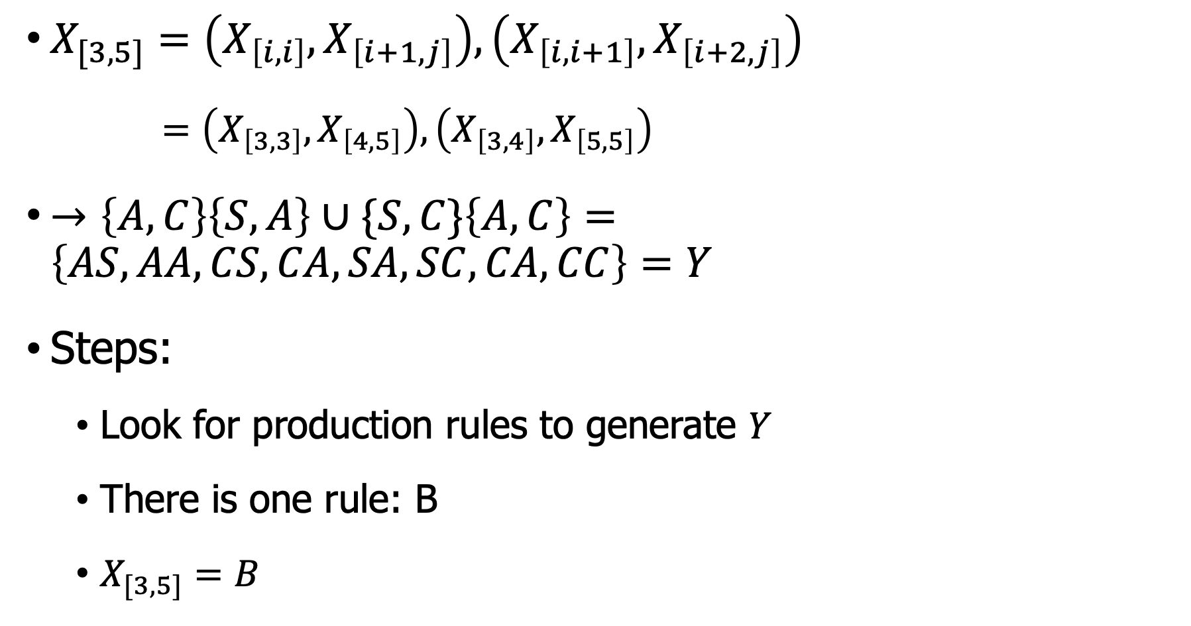
Constructing The Triangular Table
$X_{[3,5]}=\left(X_{\left[i,i\right]},X_{\left[i+1,j\right]}\right),\left(X_{\left[i,i+1\right]},X_{\left[i+2,j\right]}\right)$
$=\left(X_{\left[3,3\right]},X_{\left[4,5\right]}\right),\left(X_{\left[3,4\right]},X_{\left[5,5\right]}\right)$
$→\left\{A,C\right\}\left\{S,A\right\}∪\{S,C\}\left\{A,C\right\}=\left\{AS, AA, CS,CA,SA,SC,CA,CC\right\}=Y$
Steps:
Look for production rules to generate $Y$
There is one rule: B
$X_{[3,5]}=B$
S → AB | BC
A → BA | a
B → CC | b
C → AB | a

Slide 71
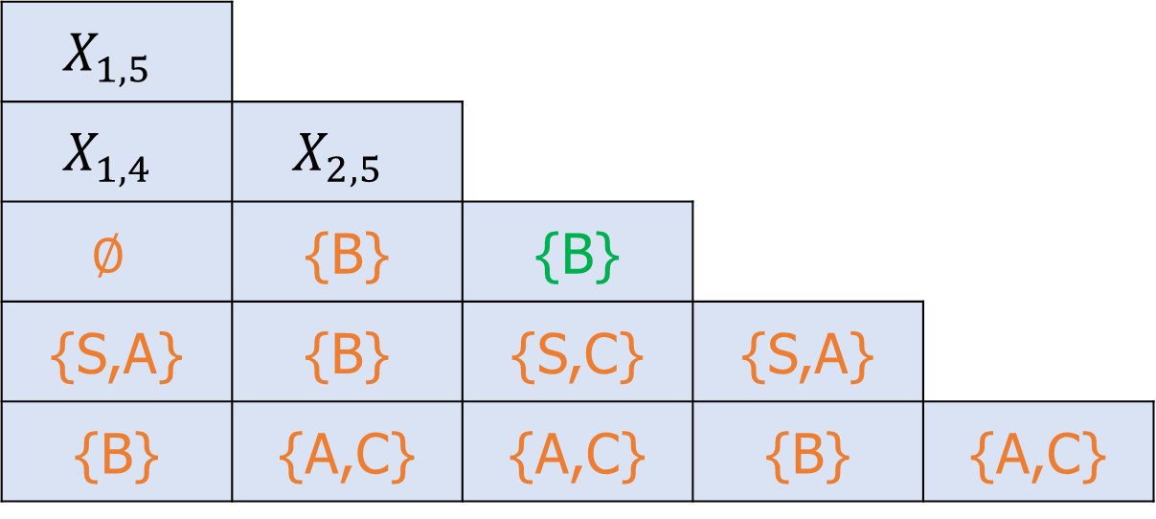
Constructing The Triangular Table
Calculated cell [3,5]
S → AB | BC
A → BA | a
B → CC | b
C → AB | a
$$X_{1,5}$$
$$X_{1,4}$$ | $$X_{2,5}$$
$$∅$$ | {B} | {B}
{S,A} | {B} | {S,C} | {S,A}
{B} | {A,C} | {A,C} | {B} | {A,C}
w = b a a b a

Slide 72
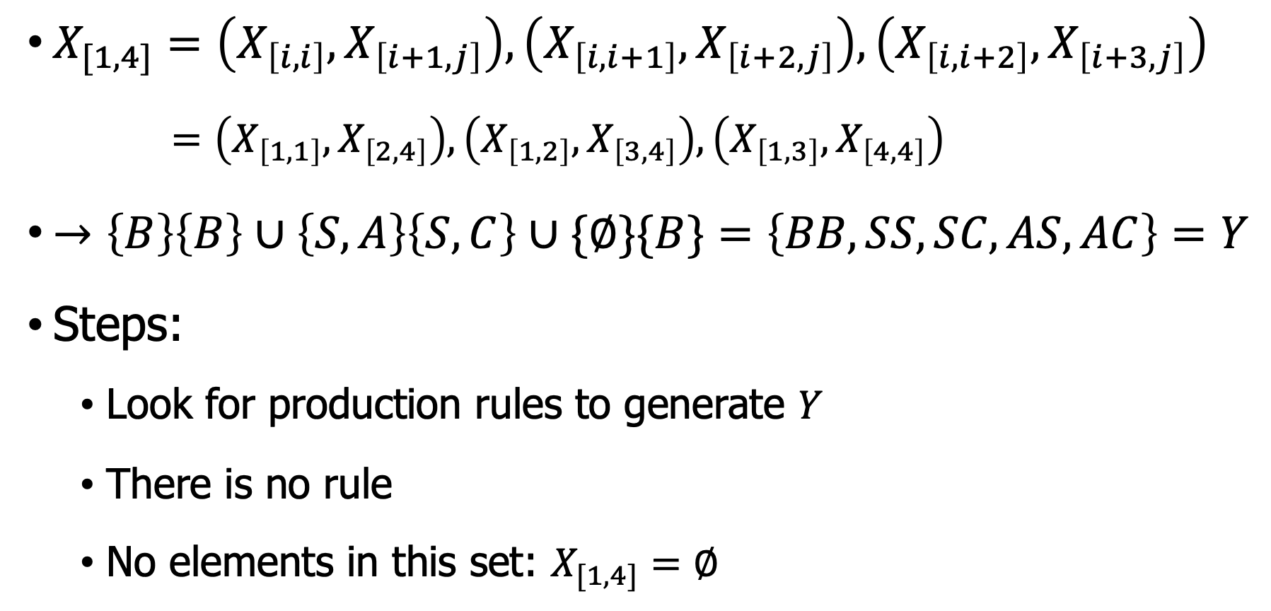
Constructing The Triangular Table
$X_{[1,4]}=\left(X_{\left[i,i\right]},X_{\left[i+1,j\right]}\right),\left(X_{\left[i,i+1\right]},X_{\left[i+2,j\right]}\right),\left(X_{\left[i,i+2\right]},X_{\left[i+3,j\right]}\right)$
$=\left(X_{\left[1,1\right]},X_{\left[2,4\right]}\right),\left(X_{\left[1,2\right]},X_{\left[3,4\right]}\right),\left(X_{\left[1,3\right]},X_{\left[4,4\right]}\right)$
$→\left\{B\right\}\left\{B\right\}∪\left\{S,A\right\}\left\{S,C\right\}∪\{∅\}\{B\}=\left\{BB, SS,SC,AS,AC\right\}=Y$
Steps:
Look for production rules to generate $Y$
There is no rule
No elements in this set: $X_{[1,4]}=∅$
S → AB | BC
A → BA | a
B → CC | b
C → AB | a

Slide 73

Constructing The Triangular Table
Calculated cell [1,4]
S → AB | BC
A → BA | a
B → CC | b
C → AB | a
$$X_{1,5}$$
$$∅$$ | $$X_{2,5}$$
$$∅$$ | {B} | {B}
{S,A} | {B} | {S,C} | {S,A}
{B} | {A,C} | {A,C} | {B} | {A,C}
w = b a a b a

Slide 74

Constructing The Triangular Table
$X_{[2,5]}=\left(X_{\left[i,i\right]},X_{\left[i+1,j\right]}\right),\left(X_{\left[i,i+1\right]},X_{\left[i+2,j\right]}\right),\left(X_{\left[i,i+1\right]},X_{\left[i+2,j\right]}\right)$
$=\left(X_{\left[2,2\right]},X_{\left[3,5\right]}\right),\left(X_{\left[2,3\right]},X_{\left[4,5\right]}\right),\left(X_{\left[2,4\right]},X_{\left[5,5\right]}\right)$
$→\left\{A,C\right\}\left\{B\right\}∪\left\{B\right\}\left\{S,A\right\}∪\{B\}\{A,C\}=\left\{AB, CB,BS,BA,BC\right\}=Y$
Steps:
Look for production rules to generate $Y$
There are three rule {S, A, C}
No elements in this set: $X_{[2,5]}=\{S,A,C\}$
S → AB | BC
A → BA | a
B → CC | b
C → AB | a

Slide 75

Constructing The Triangular Table
Calculated cell [2,5]
S → AB | BC
A → BA | a
B → CC | b
C → AB | a
$$X_{1,5}$$
$$∅$$ | {S,A,C}
$$∅$$ | {B} | {B}
{S,A} | {B} | {S,C} | {S,A}
{B} | {A,C} | {A,C} | {B} | {A,C}
w = b a a b a

Slide 76

Constructing The Triangular Table
$X_{[1,5]}=\left(X_{\left[i,i\right]},X_{\left[i+1,j\right]}\right),\left(X_{\left[i,i+1\right]},X_{\left[i+2,j\right]}\right),…$
$=\left(X_{\left[1,1\right]},X_{\left[2,5\right]}\right),\left(X_{\left[1,2\right]},X_{\left[3,5\right]}\right),\left(X_{\left[1,3\right]},X_{\left[4,5\right]}\right),\left(X_{\left[1,4\right]},X_{\left[5,5\right]}\right)$
$→\left\{B\right\}\left\{S,A,C\right\}∪\{S,A\}\left\{B\right\}=\left\{BS, BA,BC,SB,AB\right\}=Y$
Steps:
Look for production rules to generate $Y$
There are three rules {S,A,C}
No elements in this set: $X_{[1,5]}=\text{\{}\text{S}\text{,}\text{A}\text{,}\text{C}\text{\}}$
S → AB | BC
A → BA | a
B → CC | b
C → AB | a

Slide 77

Constructing The Triangular Table
Calculated cell [1,5]
S → AB | BC
A → BA | a
B → CC | b
C → AB | a
{S,A,C}
$$∅$$ | {S,A,C}
$$∅$$ | {B} | {B}
{S,A} | {B} | {S,C} | {S,A}
{B} | {A,C} | {A,C} | {B} | {A,C}
w = b a a b a

Slide 78



Final Triangular Table
{S,A,C}
$$∅$$ | {S,A,C}
$$∅$$ | {B} | {B}
{S,A} | {B} | {S,C} | {S,A}
{B} | {A,C} | {A,C} | {B} | {A,C}
$$←X_{1,5}$$
w = b a a b a
Is baaba in L(G)? Yes
We can see the S in the set $X_{1,n}$where ‘n’ = 5.
We can see the table cell $X_{1,5}=\text{\{}\text{S}\text{,}\text{A}\text{,}\text{C}\text{\}}$
If $S∈X_{\left[1,5\right]}$ then baaba $∈L(G)$

Slide 79


Dynamic example
Sentence: she eats a fish with a fork

Slide 80


Theorem
Theorem: Assume that the CYK Algorithm correctly computes $X_{[i,j]}$ for all $i$ and $j$; then $w$ is in $L(G)$ if and only if $S$ is in $X_{[1,n]}$
Time complexity of CKY
Using Big O notation, the worst case running time of CKY
$$𝒪(n^{3}⋅|G|)$$
where n is the length of the parsed string and $|G|$ is the size of the CNF grammar $G$.

Slide 81


PCFG
Which one is the best ? Use Probabilistic CFG.
Assign each rule a probability so that $\sum_{XY,a}{P(A→XY,a)=1}$.
Select the parse tree that have maximal probability.
Notes:
随机上下文无关文法，基于概率的上下文无关文法。

Slide 82

Neural-based method

Slide 83

Quiz (15 minutes)
Given the grammar
Is ababa in L(G)?
S → AB | BC
A → BA | a
B → CC | b
C → AB | a
$X_{ii}$ is the set of variables A such that A → $w_{i}$ is a rule of G.
$X_{ij}$ is the set of variables A such that A $\underset{⇒}{∗}$ $w_{i:j}$ is a rule of G.
Compare at most n pairs of previously computed sets:
($X_{[i,i]}$, $X_{[i+1,j]}$), ($X_{[i,i+1]}$, $X_{[i+2,j]}$), ($X_{[i,i+2]}$, $X_{[i+3,j]}$), … ($X_{[i, j−1]}$, $X_{[j,j]}$)
$$X_{1,5}$$
$$X_{1,4}$$ | $$X_{2,5}$$
$$X_{1,3}$$ | $$X_{2,4}$$ | $$X_{3,5}$$
$$X_{1,2}$$ | $$X_{2,3}$$ | $$X_{3,4}$$ | $$X_{4,5}$$
$$X_{1,1}$$ | $$X_{2,2}$$ | $$X_{3,3}$$ | $$X_{4,4}$$ | $$X_{5,5}$$
w = w1 w2 w3 w4 w5

Slide 84
Outline
Constituency Grammars
Constituency Parsing
Ambiguity
CKY Parsing
Convert to CNF grammar
Recognizer
Dependency Parsing
Notes:
成分分析

Slide 85
Dependency Grammar and Dependency Structure
Dependency syntax postulates that syntactic structure consists of lexical items linked by binary asymmetric relations (“arrows”) called dependencies.
Example sentence: “Bills on ports and immigration were submitted by Senator Brownback, Republican of Kansas.”
submitted
nsubjpass
auxpass
prep
The arrow connects a head (governor, superior, regent) with a dependent (modifier, inferior, subordinate)
Usually, dependencies form a tree (connected, acyclic, single-head)
Bills
were
by
prep
pobj
on
Brownback
pobj
nn
appos
ports
Senator
Republican
cc
conj
prep
and
immigration
of
pobj
Kansas
Notes:
依存句法假定句法结构由通过称为依存关系的二元不对称关系（“箭头”）链接的词汇项组成。

Slide 86

Methods of Dependency Parsing
Dynamic programming (like in the CKY algorithm)
You can do it similarly to lexicalized PCFG parsing: an $O\left(n^{5}\right)$ algorithm
Eisner (1996) gives a clever algorithm that reduces the complexity to $O\left(n^{3}\right)$, by producing parse items with heads at the ends rather than in the middle
Graph algorithms
You create a Maximum Spanning Tree for a sentence
McDonald et al.’s (2005) MSTParser scores dependencies independently using a ML classifier (he uses MIRA, for online learning, but it could be MaxEnt)
Constraint Satisfaction
Edges are eliminated that don’t satisfy hard constraints. Karlsson (1990), etc.
Deterministic parsing
Greedy choice of attachments guided by machine learning classifiers
MaltParser (Nivre et al. 2008)
Notes:
我们可以用CKY的算法。产生一个带有中心词信息的
可以使用图的方法。
直接在最大覆盖树，
使用树结构将所有的节点连接在一起。然后中间可以使用一些限制条件。
这是在人工智能里，进行书树搜索时候的一种
约束满足问题。
我们可以使用机器学习方法，依次寻找对于没一个单词来说，最有可能的中心词是谁。
使用机器学习的方法效果是更好的。

Slide 87
References
[1] The CKY algorithm, https://www.cs.ucdavis.edu/~rogaway/classes/120/winter12/CYK.pdf

Slide 88
Summary
You have learned
Syntactic parsing
Constituency parsing
Context-free grammars
CKY algorithms as a recognizer

Slide 89
From words to concepts
Linking terms to synonyms to obtain a higher level of abstraction
Word-sense disambiguation + WordNet + Multilingual Central Repository + Framenet + PropBank
Stop, quit, leave, relinquish, bow out -> all linked to the concept wn:leave_office

Slide 90
Event Extraction
Event Extraction is the task of recognizing and classifying mentions of ‘things that happen’ in text
Events are multifaceted: they take place at a certain time and place and have participants involved
By recognizing participants, times and places, we can generate event descriptions and compare events.

